Slide 1

Unit-1 MS Word - I
Office Automation Tools (OAT)
DU #2304DU004
Prof. Firoz A. Sherasiya
Computer Science and Engineering Department
firoz.sherasiya@darshan.ac.in
9879879861

Slide 2
Topics to be covered
Text formatting and saving file
Styles and content
Working with objects
Design

Looping

Slide 3
Text formatting and saving file

Slide 4
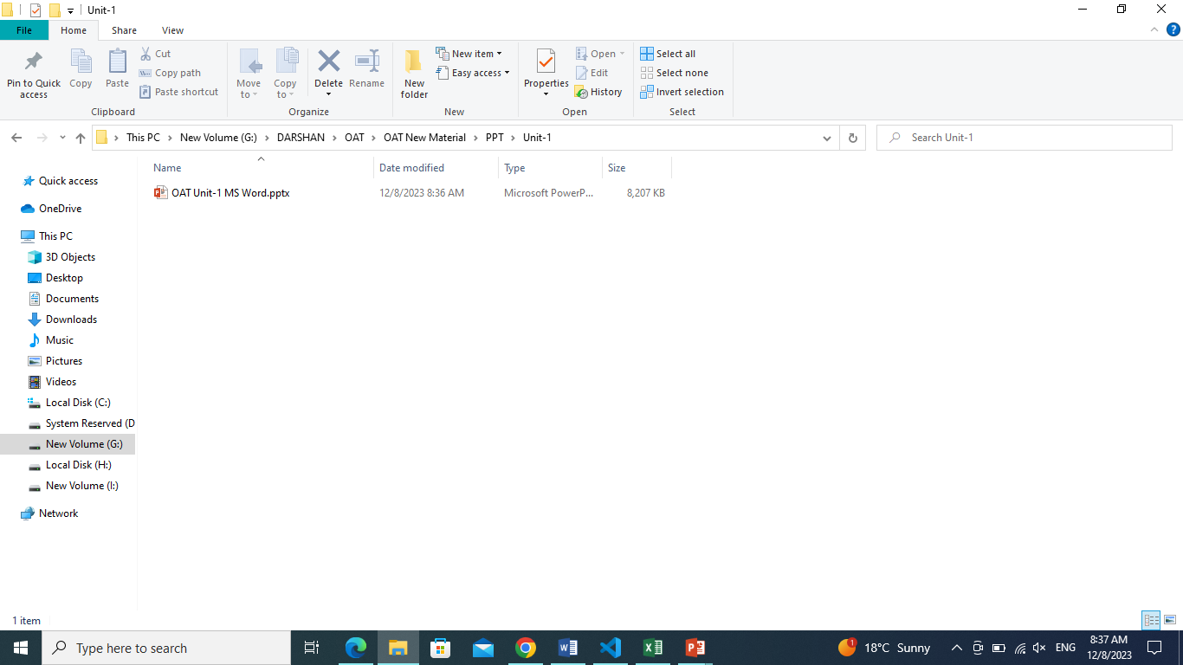
How to create a Word file
Steps to create a word file:
Open a desired folder, to create a word file.

Slide 5
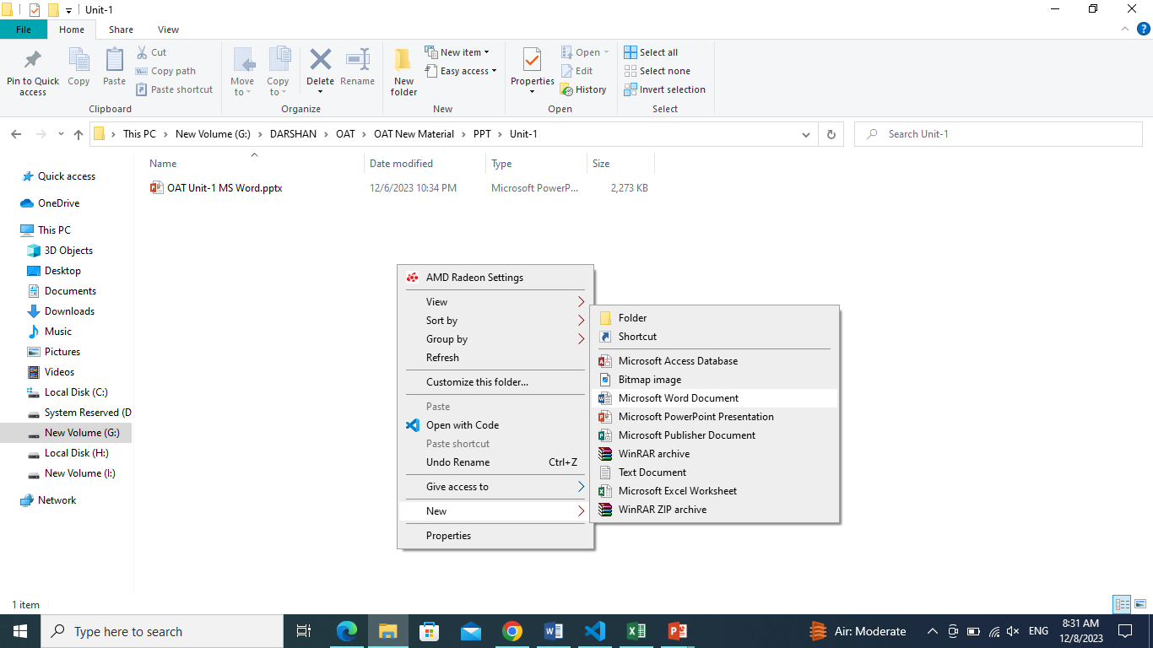
How to create a Word file
Steps to create a word file:
Open a desired folder, to create a word file.
Right click on white space area and go to New,
Select Microsoft Word Document.

Slide 6
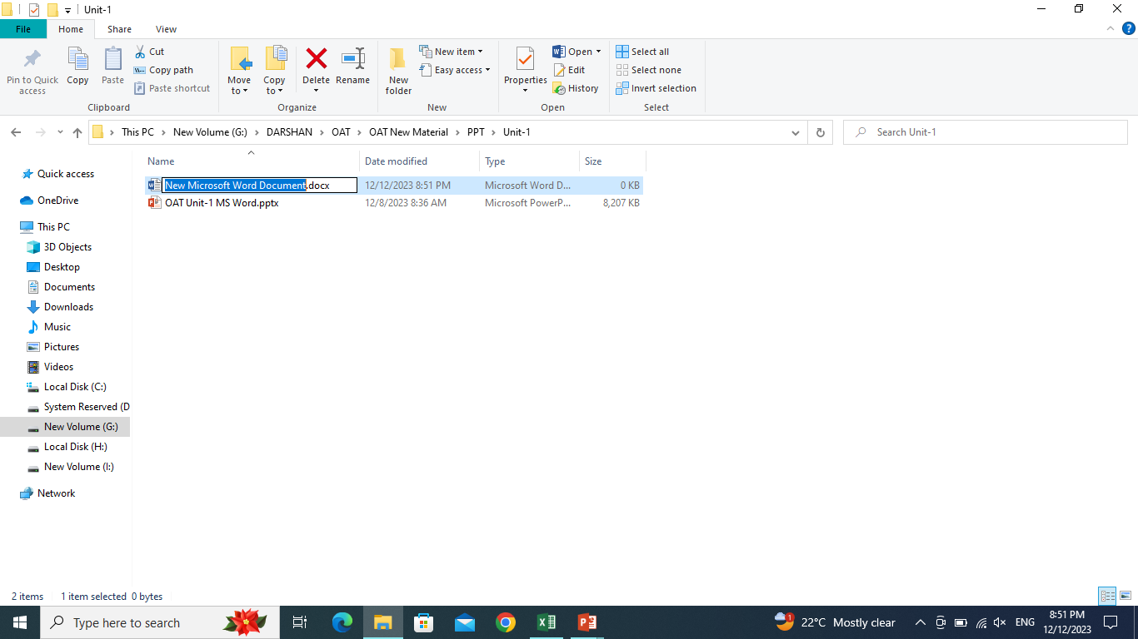
How to create a Word file
Steps to create a word file:
Open a desired folder, to create a word file.
Right click on white space area and go to New,
Select Microsoft Word Document.
Give appropriate name to the word file and press enter.

Slide 7
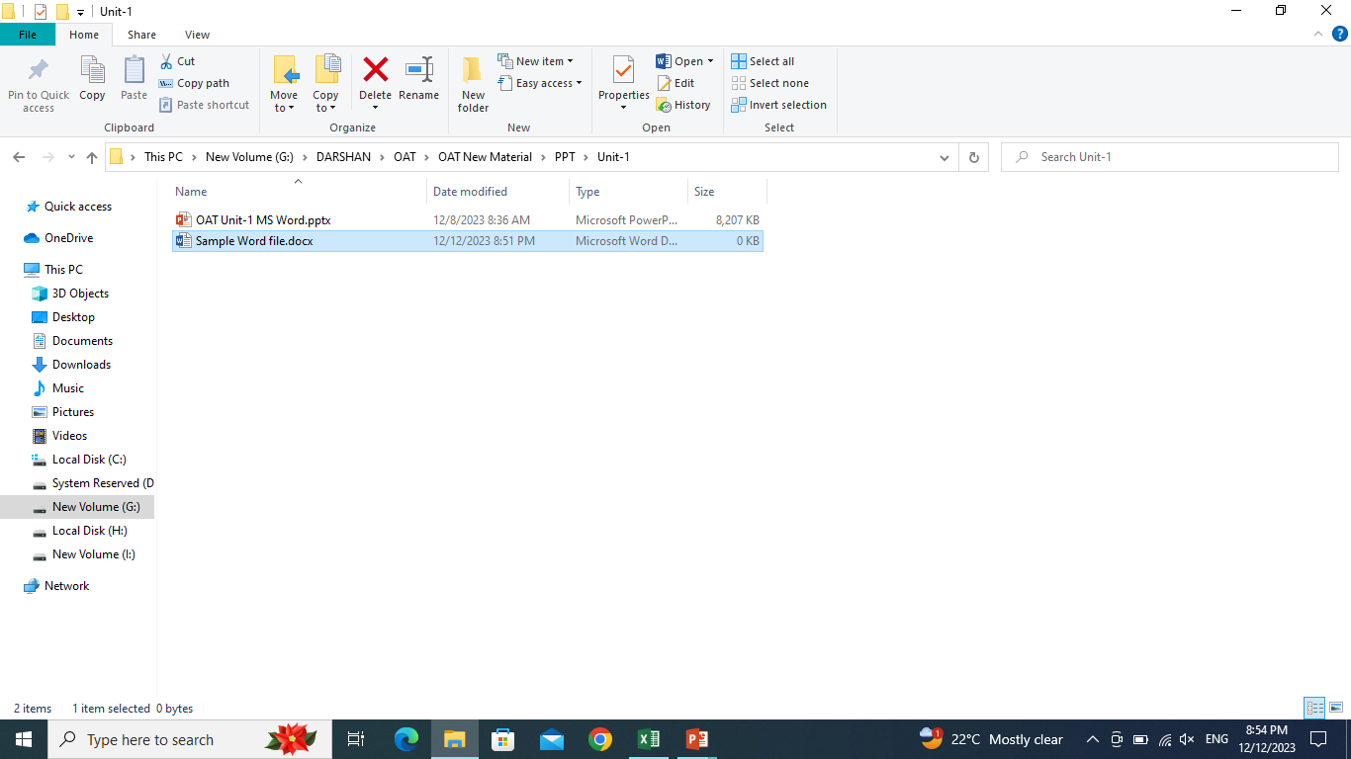
How to create a Word file
Steps to create a word file:
Open a desired folder, to create a word file.
Right click on white space area and go to New,
Select Microsoft Word Document.
Give appropriate name to the word file and press enter.

Slide 8
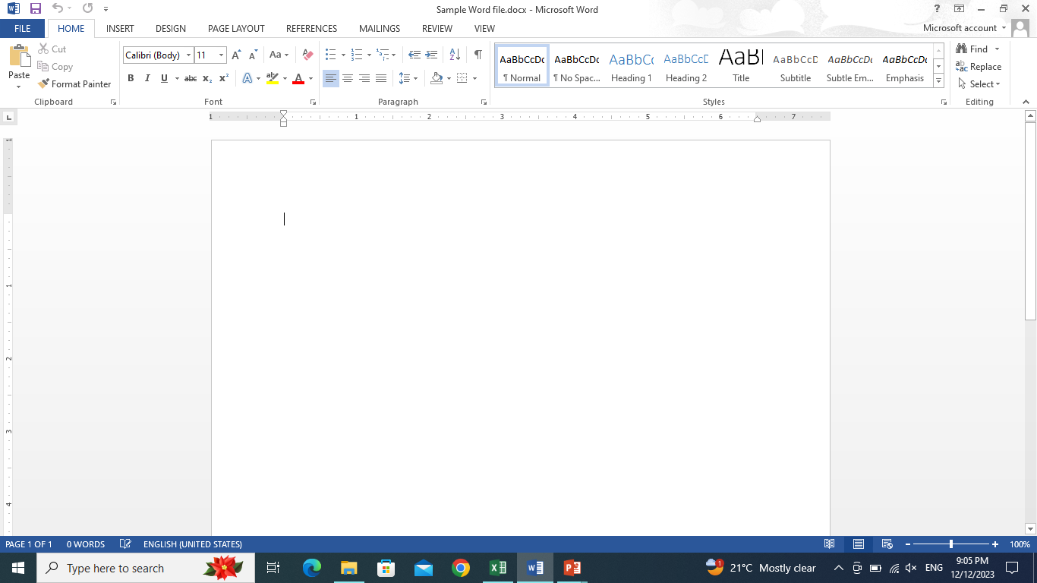
How to create a Word file
Steps to create a word file:
Open a desired folder, to create a word file.
Right click on white space area and go to New,
Select Microsoft Word Document.
Give appropriate name to the word file and press enter.
To open this word file, press enter or double click on it.

Slide 9
Introduction to the Home Page of the Word file
Workspace
Title Bar
Minimize, Restore, Close
Customize Quick Access Tool Bar
Tab
Ribbon
Rulers
Scroll Bar
Status Bar
4
2
5
3
6
7
8
7
1
9

Slide 10
Introduction to the Home Page of the Word file
Category Groups
Dialog Box Launcher
Collapse the Ribbon
Zoom Level
Read Mode, Print Layout, Web Layout
10
10
11
11
12
14
13

Slide 11
Steps to change font and font size
Steps to change Case
Steps to change Font Color of the text
Steps to Bold / Italic / Underline / Strikethrough the text
Steps to Subscript and Superscript the text
Steps to Highlight text and to give Text Effects & Typography
Steps to Clear All Formatting
Home Tab - Font Group

Slide 12
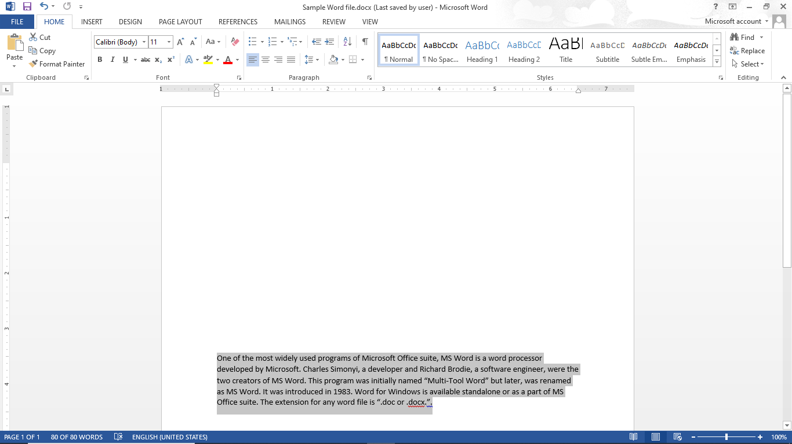
Home Tab – Font Group
Steps to change font and font size:
Select that data by using mouse cursor or Shift + up/down arrow key or Ctrl + a.

Slide 13
Home Tab – Font Group
Steps to change font and font size:
Select that data by using mouse cursor or Shift + up/down arrow key or Ctrl + a.
Go to the Font group in Home Tab.

Slide 14
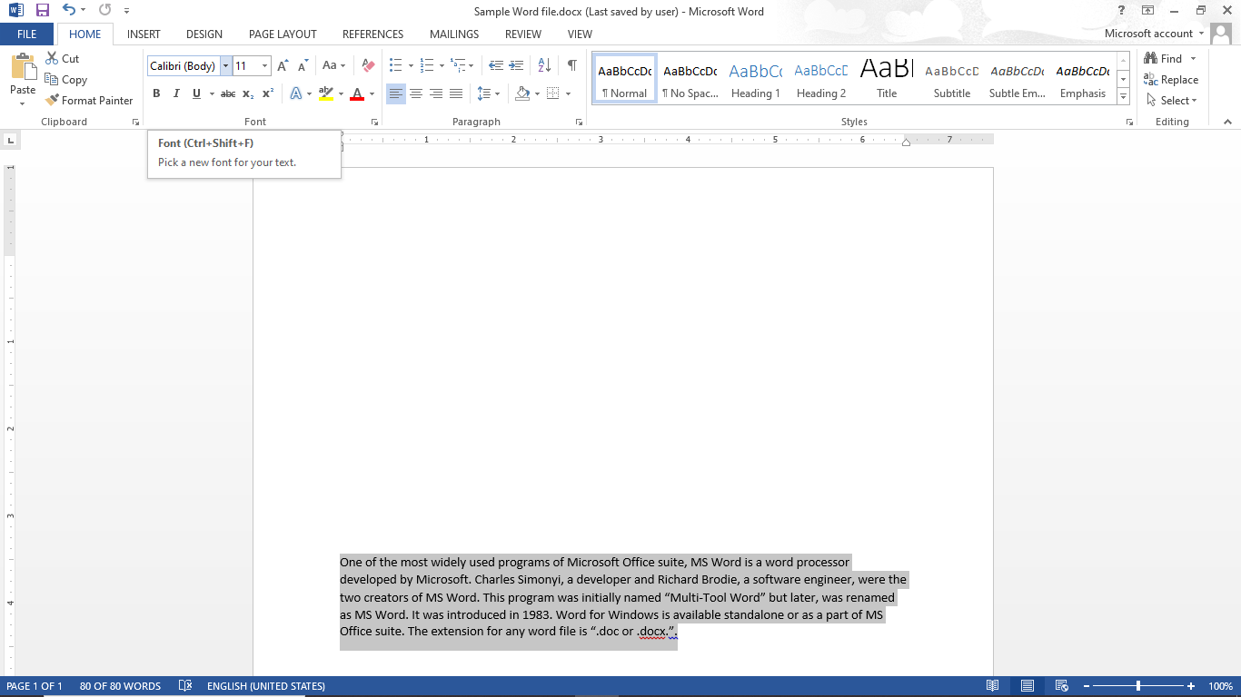
Home Tab – Font Group
Steps to change font and font size:
Select that data by using mouse cursor or Shift + up/down arrow key or Ctrl + a.
Go to the Font group in Home Tab.
Select font drop down and font size drop down to select the desired font and font size.

Slide 15
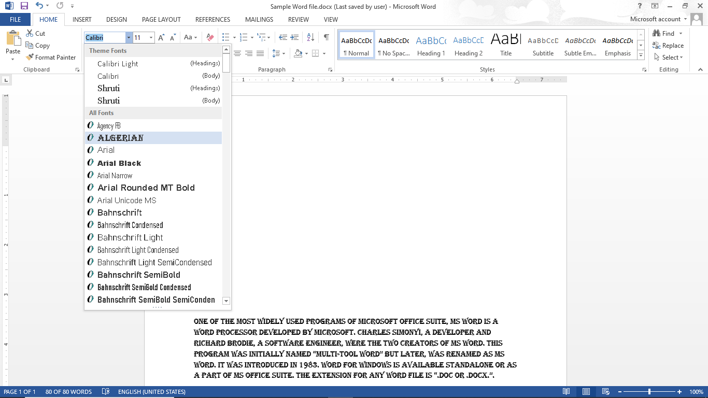
Home Tab – Font Group
Steps to change font and font size:
Select that data by using mouse cursor or Shift + up/down arrow key or Ctrl + a.
Go to the Font group in Home Tab.
Select font drop down and font size drop down to select the desired font and font size.

Slide 16
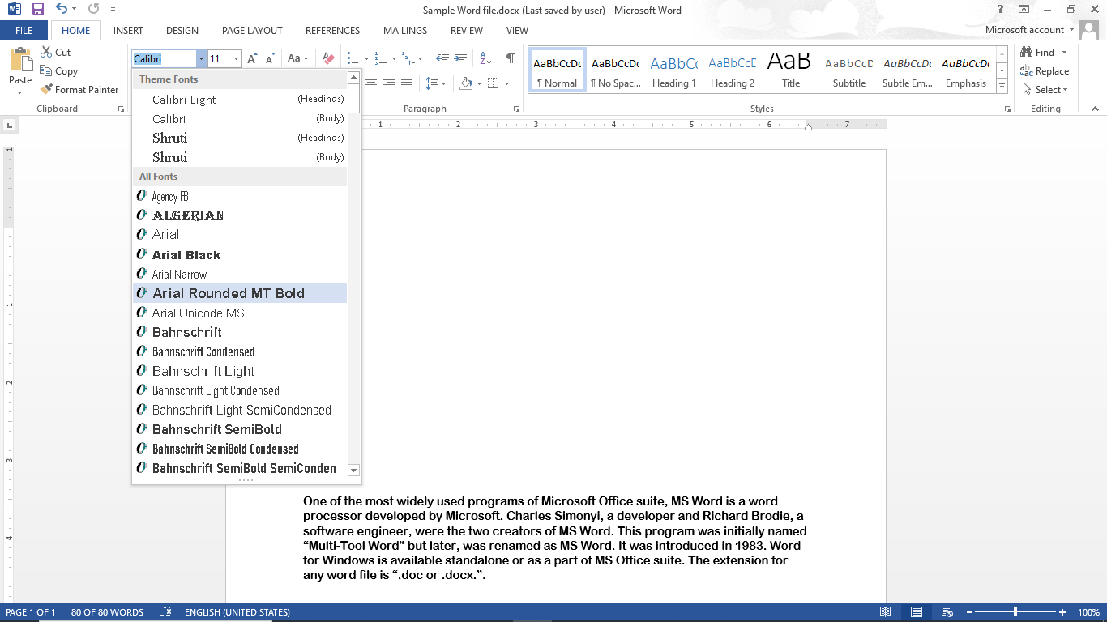
Home Tab – Font Group
Steps to change font and font size:
Select that data by using mouse cursor or Shift + up/down arrow key or Ctrl + a.
Go to the Font group in Home Tab.
Select font drop down and font size drop down to select the desired font and font size.

Slide 17
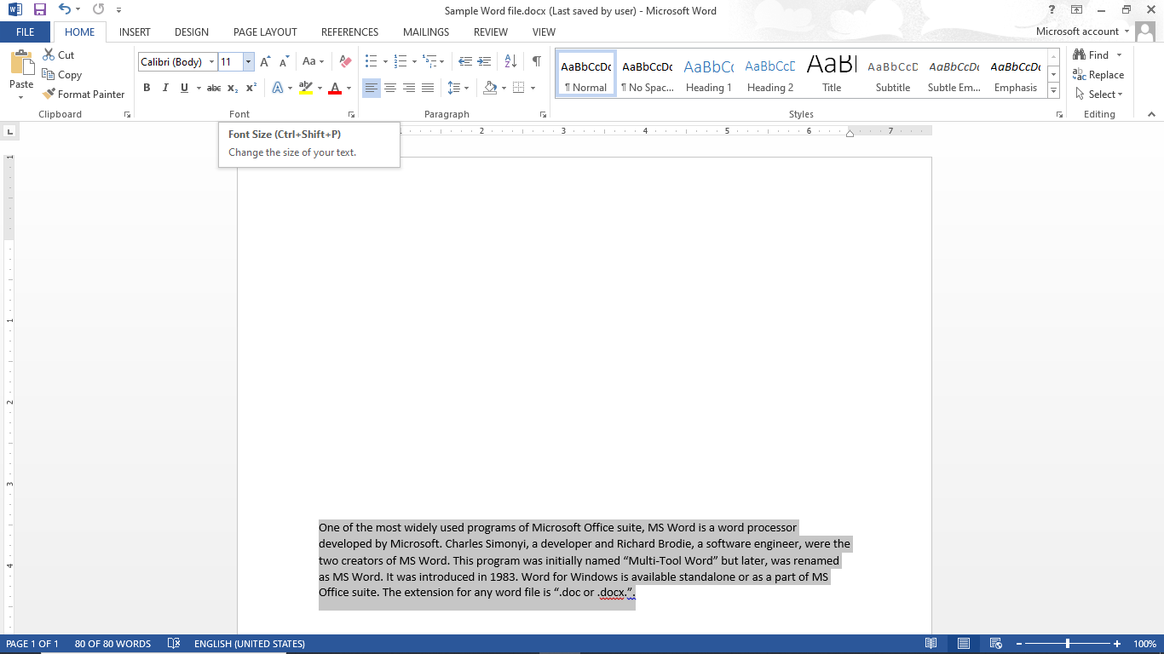
Home Tab – Font Group
Steps to change font and font size:
Select that data by using mouse cursor or Shift + up/down arrow key or Ctrl + a.
Go to the Font group in Home Tab.
Select font drop down and font size drop down to select the desired font and font size.

Slide 18
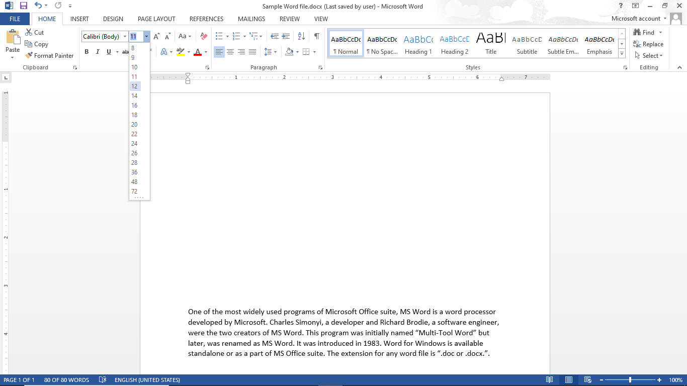
Home Tab – Font Group
Steps to change font and font size:
Select that data by using mouse cursor or Shift + up/down arrow key or Ctrl + a.
Go to the Font group in Home Tab.
Select font drop down and font size drop down to select the desired font and font size.

Slide 19
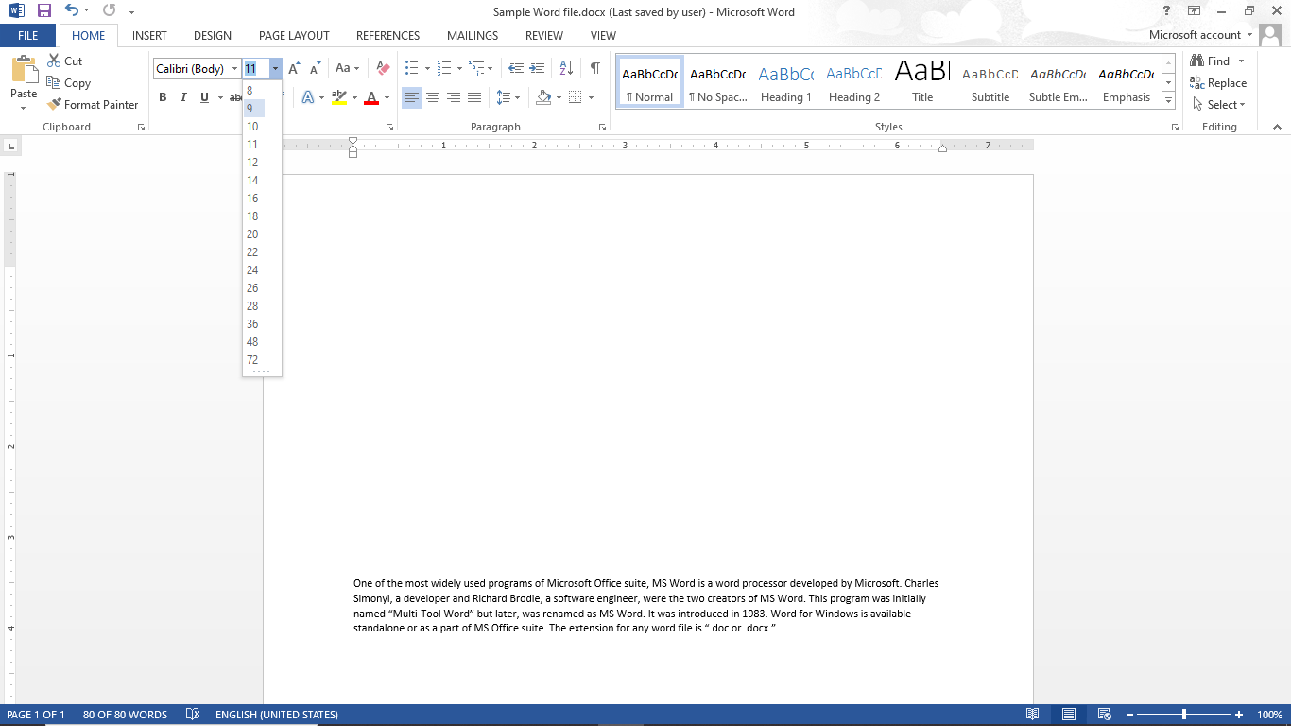
Home Tab – Font Group
Steps to change font and font size:
Select that data by using mouse cursor or Shift + up/down arrow key or Ctrl + a.
Go to the Font group in Home Tab.
Select font drop down and font size drop down to select the desired font and font size.

Slide 20
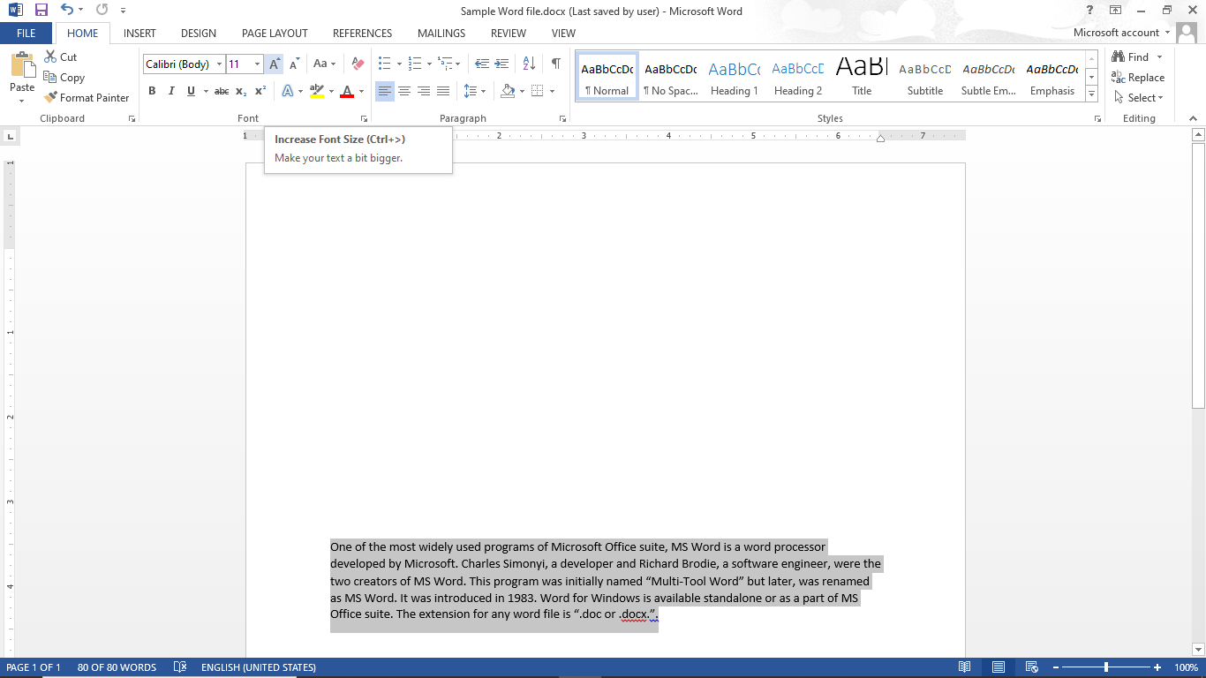
Home Tab – Font Group
Steps to change font and font size:
Select that data by using mouse cursor or Shift + up/down arrow key or Ctrl + a.
Go to the Font group in Home Tab.
Select font drop down and font size drop down to select the desired font and font size.
Font size can be increase/decrease using Increase/Decrease Font size button.

Slide 21
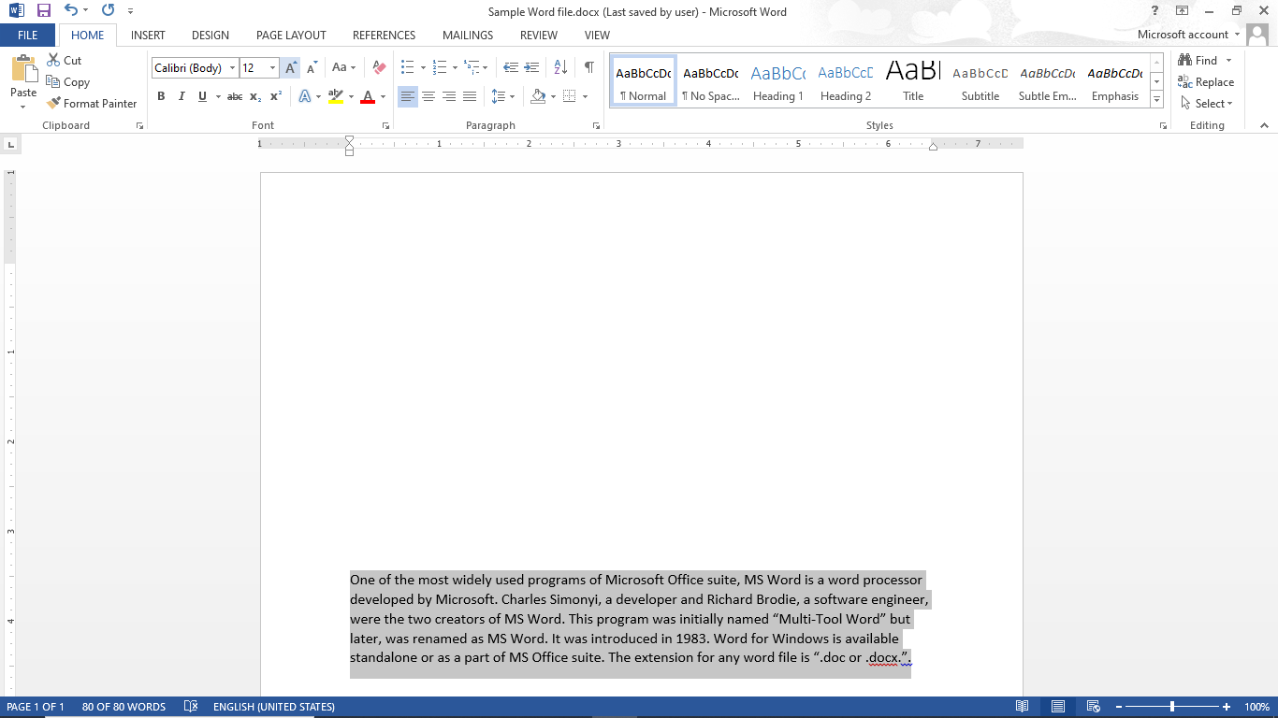
Home Tab – Font Group
Steps to change font and font size:
Select that data by using mouse cursor or Shift + up/down arrow key or Ctrl + a.
Go to the Font group in Home Tab.
Select font drop down and font size drop down to select the desired font and font size.
Font size can be increase/decrease using Increase/Decrease Font size button.

Slide 22
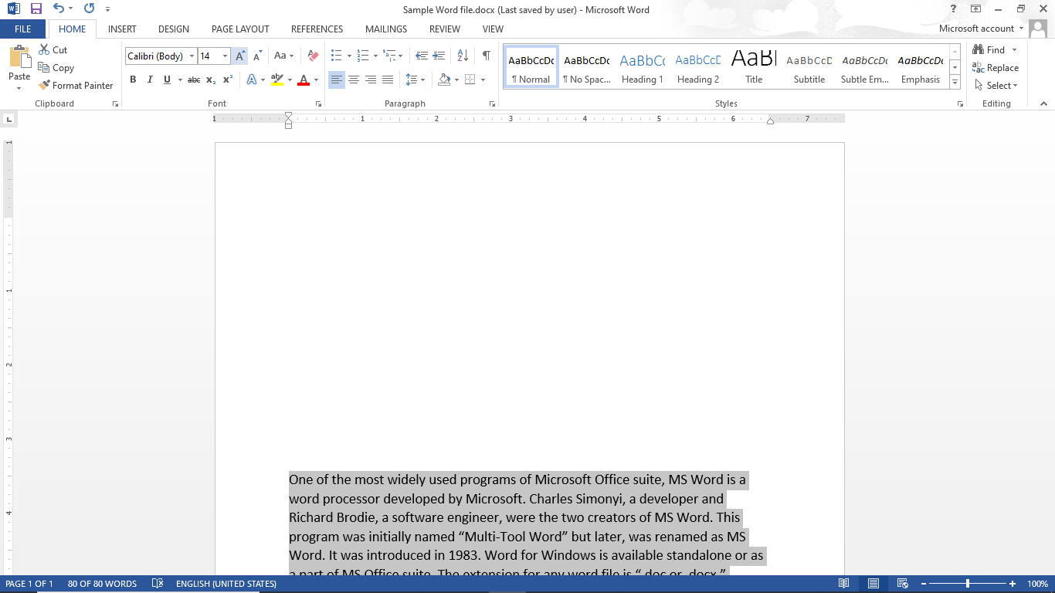
Home Tab – Font Group
Steps to change font and font size:
Select that data by using mouse cursor or Shift + up/down arrow key or Ctrl + a.
Go to the Font group in Home Tab.
Select font drop down and font size drop down to select the desired font and font size.
Font size can be increase/decrease using Increase/Decrease Font size button.

Slide 23
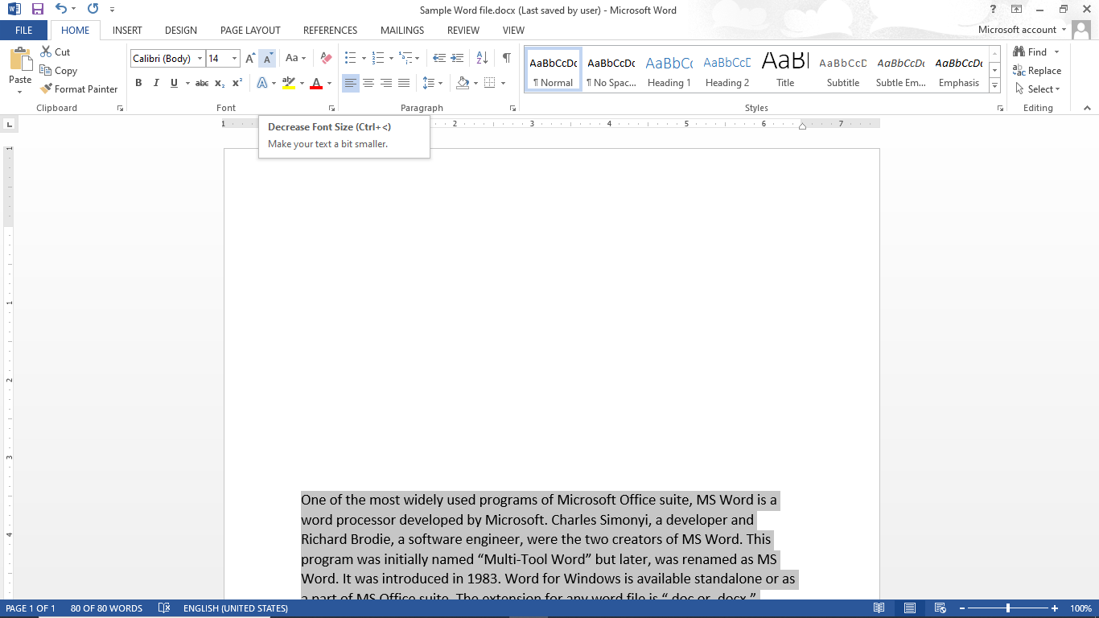
Home Tab – Font Group
Steps to change font and font size:
Select that data by using mouse cursor or Shift + up/down arrow key or Ctrl + a.
Go to the Font group in Home Tab.
Select font drop down and font size drop down to select the desired font and font size.
Font size can be increase/decrease using Increase/Decrease Font size button.

Slide 24

Home Tab – Font Group
Steps to change font and font size:
Select that data by using mouse cursor or Shift + up/down arrow key or Ctrl + a.
Go to the Font group in Home Tab.
Select font drop down and font size drop down to select the desired font and font size.
Font size can be increase/decrease using Increase/Decrease Font size button.

Slide 25
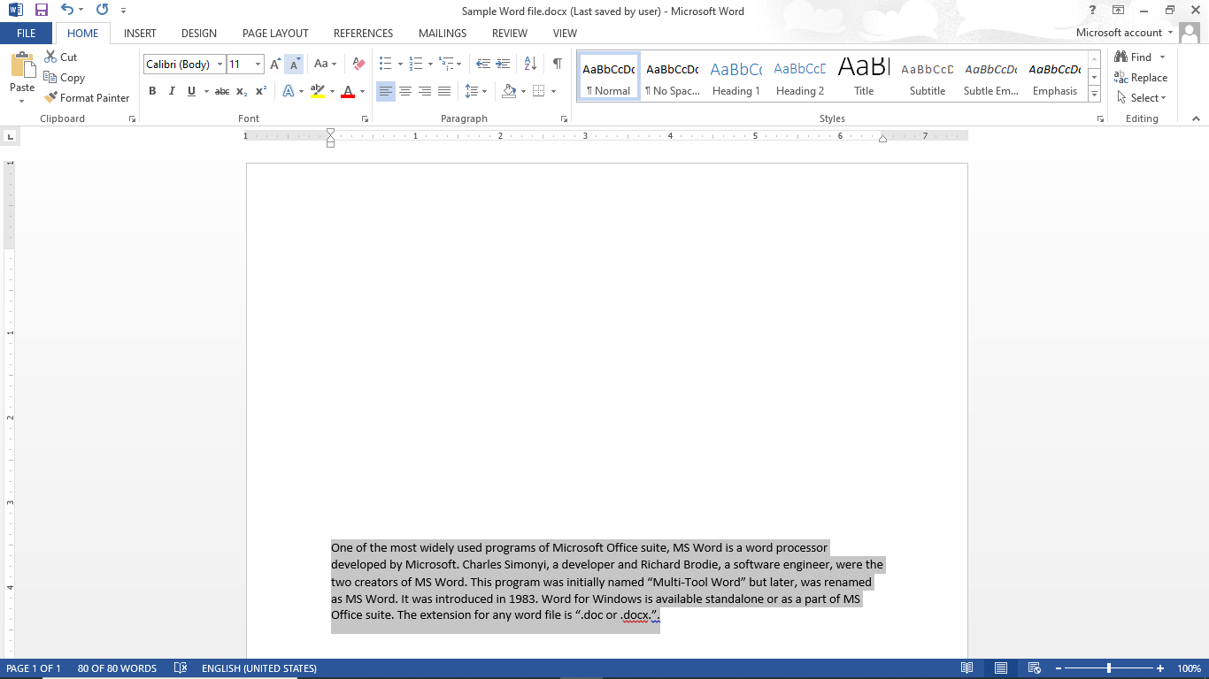
Home Tab – Font Group
Steps to change font and font size:
Select that data by using mouse cursor or Shift + up/down arrow key or Ctrl + a.
Go to the Font group in Home Tab.
Select font drop down and font size drop down to select the desired font and font size.
Font size can be increase/decrease using Increase/Decrease Font size button.

Slide 26
Steps to change font and font size
Steps to change Case
Steps to change Font Color of the text
Steps to Bold / Italic / Underline / Strikethrough the text
Steps to Subscript and Superscript the text
Steps to Highlight text and to give Text Effects & Typography
Steps to Clear All Formatting
Home Tab - Font Group

Slide 27
Home Tab – Font Group
Steps to change case:
Select that data by using mouse cursor or Shift + up/down arrow key or Ctrl + a.

Slide 28
Home Tab – Font Group
Steps to change case:
Select that data by using mouse cursor or Shift + up/down arrow key or Ctrl + a.
Go to the Font group in Home Tab.

Slide 29
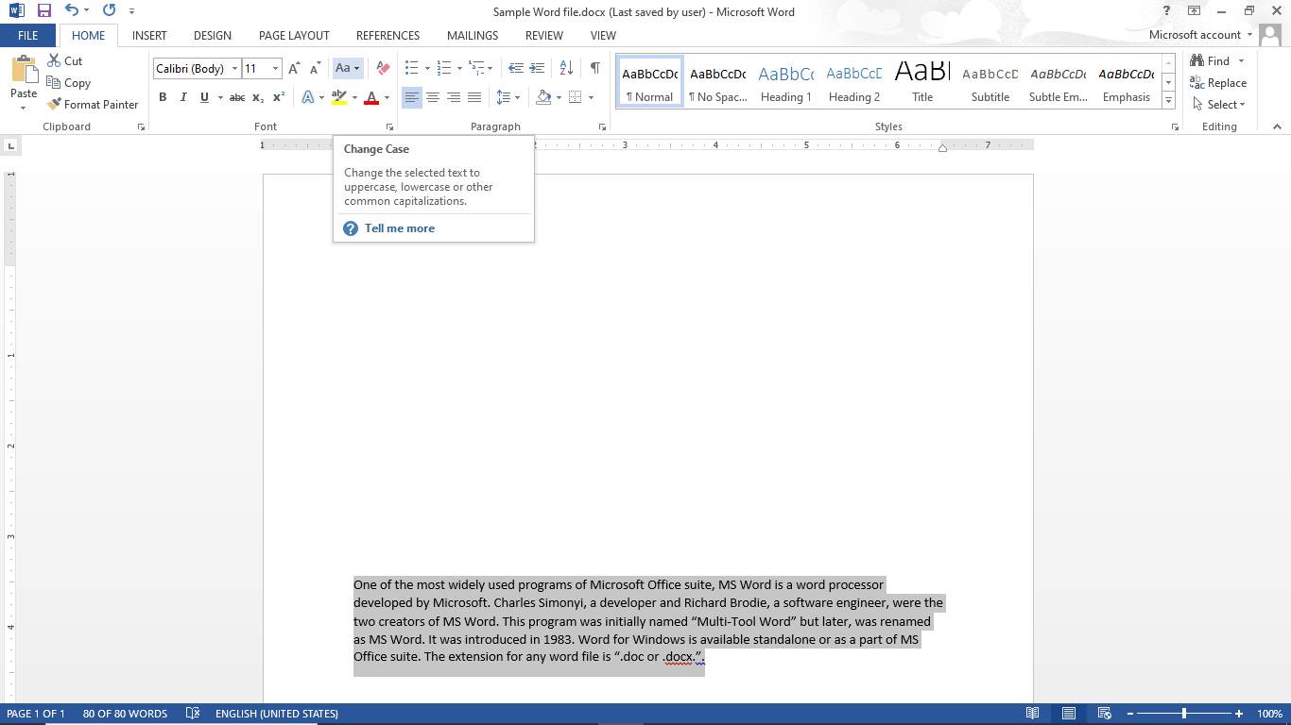
Home Tab – Font Group
Steps to change case:
Select that data by using mouse cursor or Shift + up/down arrow key or Ctrl + a.
Go to the Font group in Home Tab.
Select Change Case drop down to set the desired case.

Slide 30
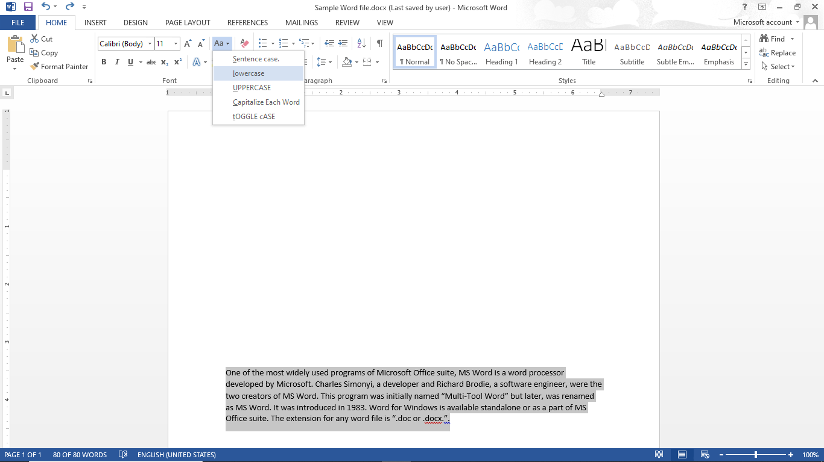
Home Tab – Font Group
Steps to change case:
Select that data by using mouse cursor or Shift + up/down arrow key or Ctrl + a.
Go to the Font group in Home Tab.
Select Change Case drop down to set the desired case.

Slide 31
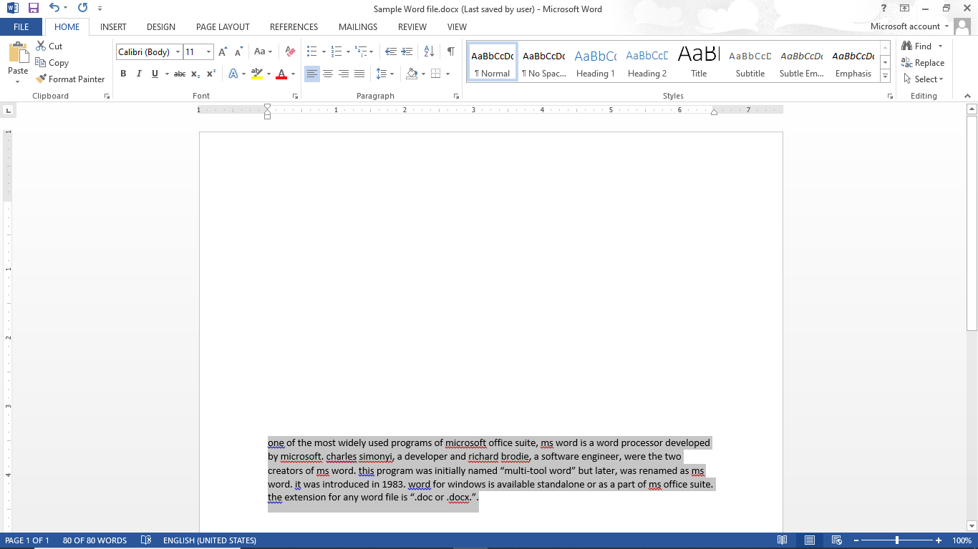
Home Tab – Font Group
Steps to change case:
Select that data by using mouse cursor or Shift + up/down arrow key or Ctrl + a.
Go to the Font group in Home Tab.
Select Change Case drop down to set the desired case.

Slide 32
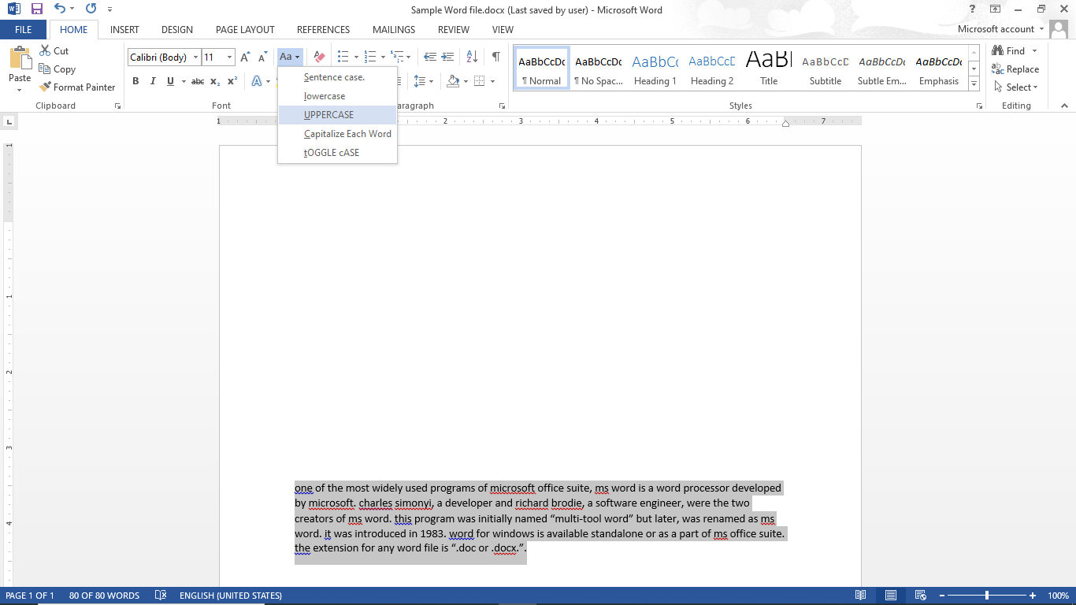
Home Tab – Font Group
Steps to change case:
Select that data by using mouse cursor or Shift + up/down arrow key or Ctrl + a.
Go to the Font group in Home Tab.
Select Change Case drop down to set the desired case.

Slide 33
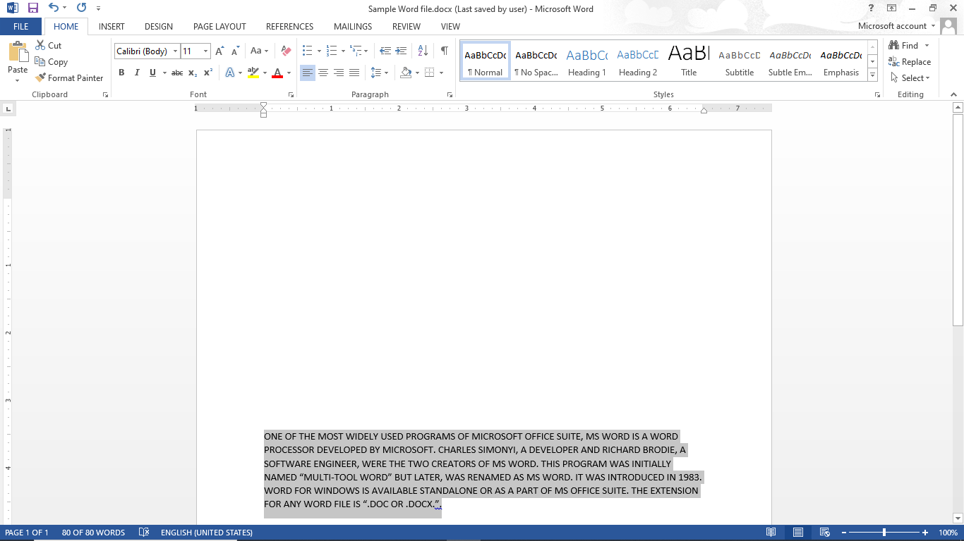
Home Tab – Font Group
Steps to change case:
Select that data by using mouse cursor or Shift + up/down arrow key or Ctrl + a.
Go to the Font group in Home Tab.
Select Change Case drop down to set the desired case.

Slide 34
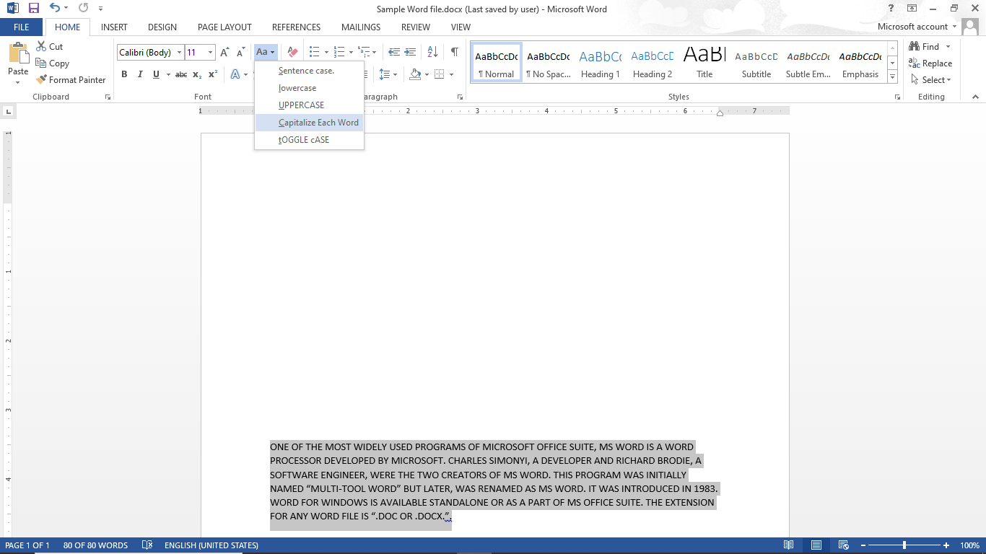
Home Tab – Font Group
Steps to change case:
Select that data by using mouse cursor or Shift + up/down arrow key or Ctrl + a.
Go to the Font group in Home Tab.
Select Change Case drop down to set the desired case.

Slide 35
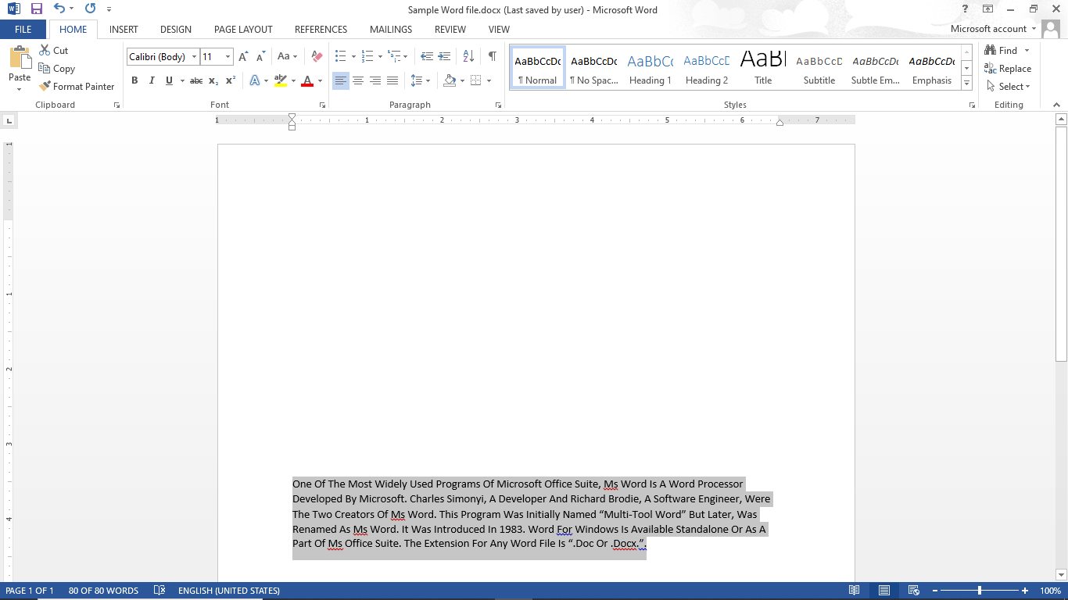
Home Tab – Font Group
Steps to change case:
Select that data by using mouse cursor or Shift + up/down arrow key or Ctrl + a.
Go to the Font group in Home Tab.
Select Change Case drop down to set the desired case.

Slide 36
Steps to change font and font size
Steps to change Case
Steps to change Font Color of the text
Steps to Bold / Italic / Underline / Strikethrough the text
Steps to Subscript and Superscript the text
Steps to Highlight text and to give Text Effects & Typography
Steps to Clear All Formatting
Home Tab - Font Group

Slide 37
Home Tab – Font Group
Steps to Bold / Italic / Underline / Strikethrough the text:
Select that data by using mouse cursor or Shift + up/down arrow key or Ctrl + a.

Slide 38
Home Tab – Font Group
Steps to Bold / Italic / Underline / Strikethrough the text:
Select that data by using mouse cursor or Shift + up/down arrow key or Ctrl + a.
Go to the Font group in Home Tab.

Slide 39

Home Tab – Font Group
Steps to Bold / Italic / Underline / Strikethrough the text:
Select that data by using mouse cursor or Shift + up/down arrow key or Ctrl + a.
Go to the Font group in Home Tab.
Click on B for Bold font, I for Italic fonts, U for underline and abc for Strikethrough the fonts.

Slide 40

Home Tab – Font Group
Steps to Bold / Italic / Underline / Strikethrough the text:
Select that data by using mouse cursor or Shift + up/down arrow key or Ctrl + a.
Go to the Font group in Home Tab.
Click on B for Bold font, I for Italic fonts, U for underline and abc for Strikethrough the fonts.

Slide 41

Home Tab – Font Group
Steps to Bold / Italic / Underline / Strikethrough the text:
Select that data by using mouse cursor or Shift + up/down arrow key or Ctrl + a.
Go to the Font group in Home Tab.
Click on B for Bold font, I for Italic fonts, U for underline and abc for Strikethrough the fonts.

Slide 42
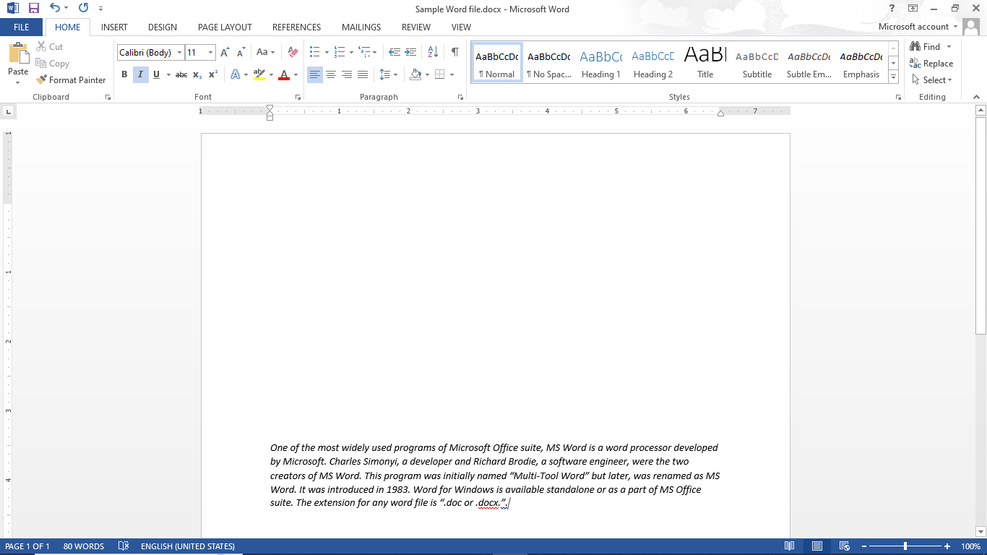
Home Tab – Font Group
Steps to Bold / Italic / Underline / Strikethrough the text:
Select that data by using mouse cursor or Shift + up/down arrow key or Ctrl + a.
Go to the Font group in Home Tab.
Click on B for Bold font, I for Italic fonts, U for underline and abc for Strikethrough the fonts.

Slide 43
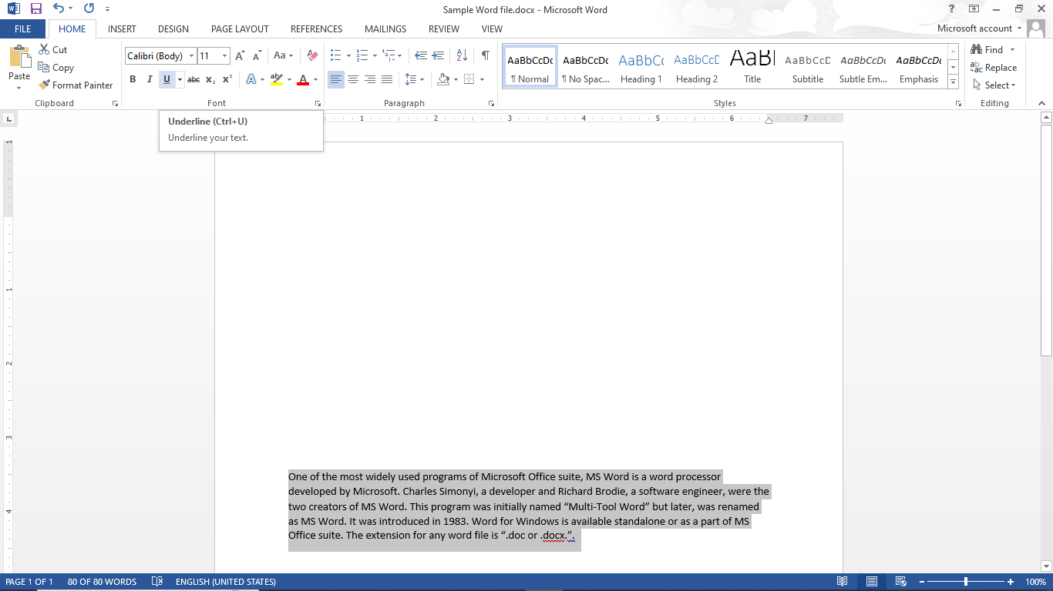
Home Tab – Font Group
Steps to Bold / Italic / Underline / Strikethrough the text:
Select that data by using mouse cursor or Shift + up/down arrow key or Ctrl + a.
Go to the Font group in Home Tab.
Click on B for Bold font, I for Italic fonts, U for underline and abc for Strikethrough the fonts.

Slide 44
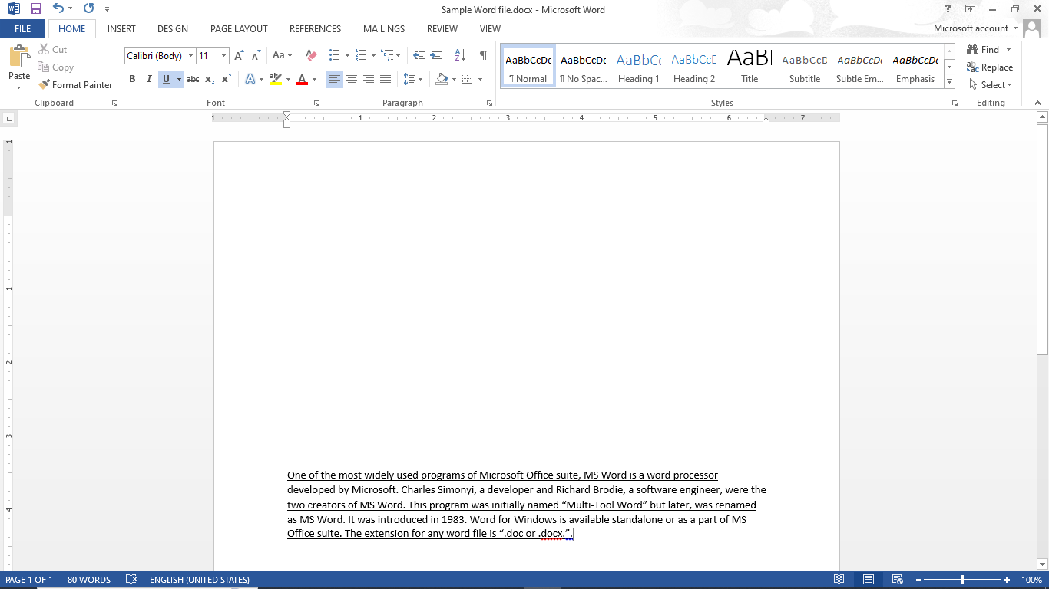
Home Tab – Font Group
Steps to Bold / Italic / Underline / Strikethrough the text:
Select that data by using mouse cursor or Shift + up/down arrow key or Ctrl + a.
Go to the Font group in Home Tab.
Click on B for Bold font, I for Italic fonts, U for underline and abc for Strikethrough the fonts.

Slide 45
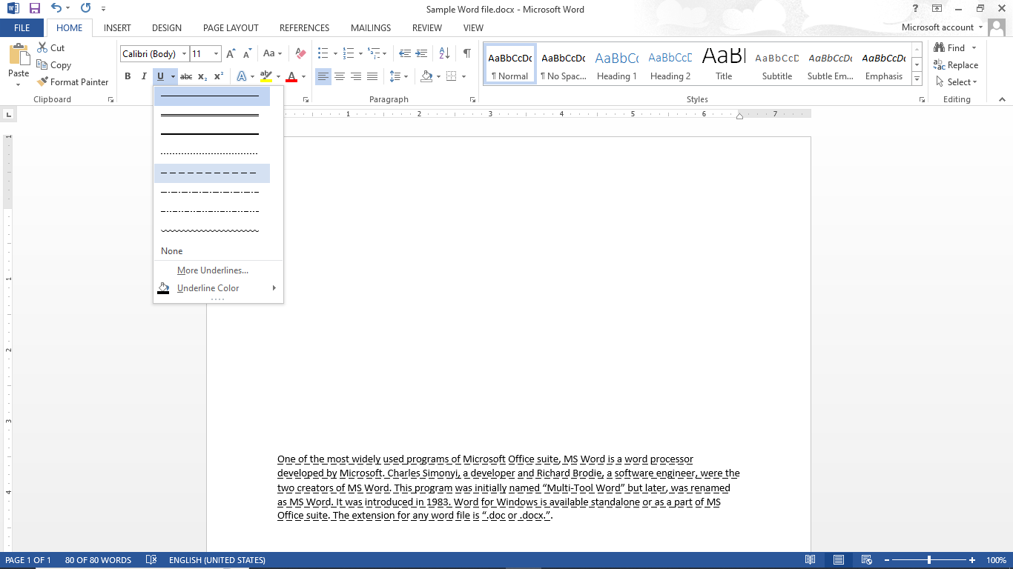
Home Tab – Font Group
Steps to Bold / Italic / Underline / Strikethrough the text:
Select that data by using mouse cursor or Shift + up/down arrow key or Ctrl + a.
Go to the Font group in Home Tab.
Click on B for Bold font, I for Italic fonts, U for underline and abc for Strikethrough the fonts.

Slide 46
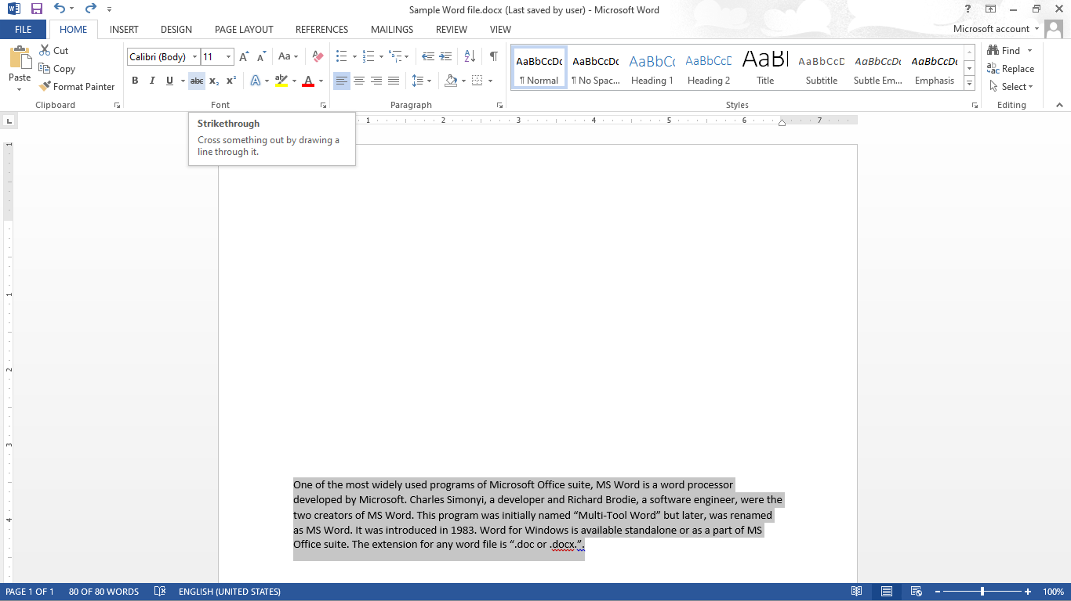
Home Tab – Font Group
Steps to Bold / Italic / Underline / Strikethrough the text:
Select that data by using mouse cursor or Shift + up/down arrow key or Ctrl + a.
Go to the Font group in Home Tab.
Click on B for Bold font, I for Italic fonts, U for underline and abc for Strikethrough the fonts.

Slide 47
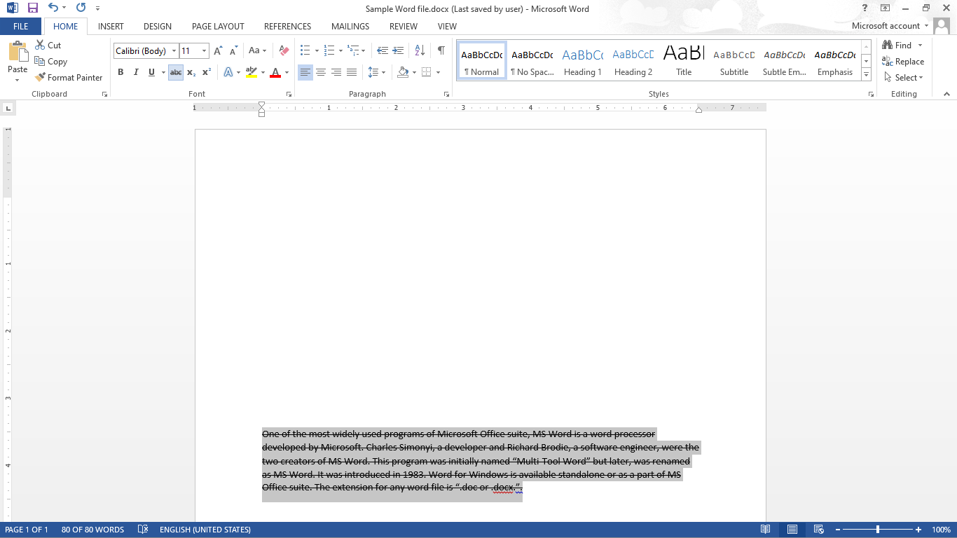
Home Tab – Font Group
Steps to Bold / Italic / Underline / Strikethrough the text:
Select that data by using mouse cursor or Shift + up/down arrow key or Ctrl + a.
Go to the Font group in Home Tab.
Click on B for Bold font, I for Italic fonts, U for underline and abc for Strikethrough the fonts.

Slide 48
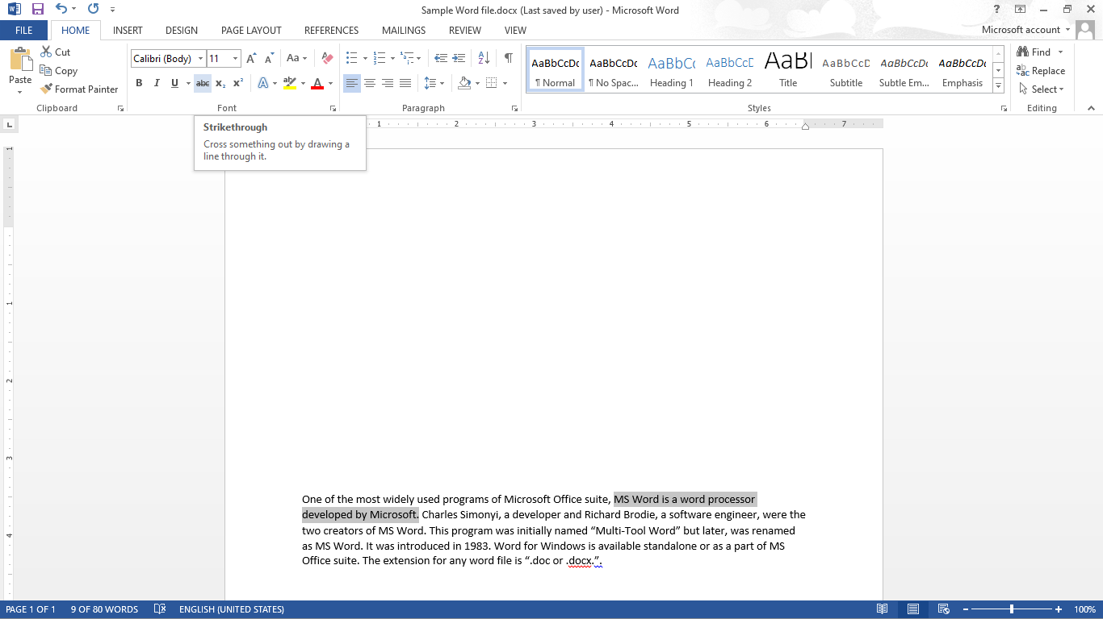
Home Tab – Font Group
Steps to Bold / Italic / Underline / Strikethrough the text:
Select that data by using mouse cursor or Shift + up/down arrow key or Ctrl + a.
Go to the Font group in Home Tab.
Click on B for Bold font, I for Italic fonts, U for underline and abc for Strikethrough the fonts.

Slide 49
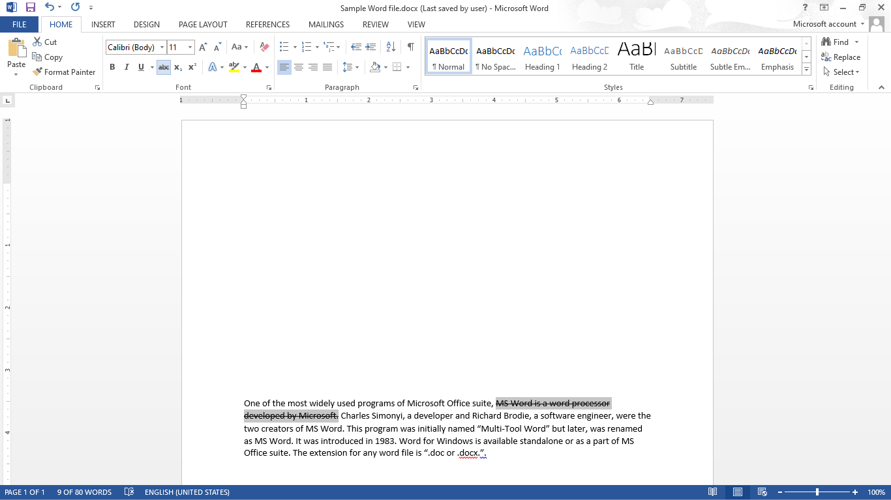
Home Tab – Font Group
Steps to Bold / Italic / Underline / Strikethrough the text:
Select that data by using mouse cursor or Shift + up/down arrow key or Ctrl + a.
Go to the Font group in Home Tab.
Click on B for Bold font, I for Italic fonts, U for underline and abc for Strikethrough the fonts.

Slide 50
Steps to change font and font size
Steps to change Case
Steps to change Font Color of the text
Steps to Bold / Italic / Underline / Strikethrough the text
Steps to Subscript and Superscript the text
Steps to Highlight text and to give Text Effects & Typography
Steps to Clear All Formatting
Home Tab - Font Group

Slide 51
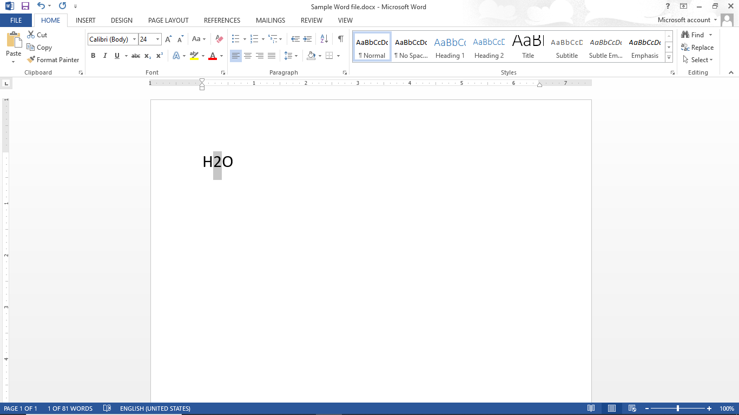
Home Tab – Font Group
Steps to Subscript and Superscript text:
Select that data for subscript by using mouse cursor or Shift + up/down/left/right arrow key.

Slide 52
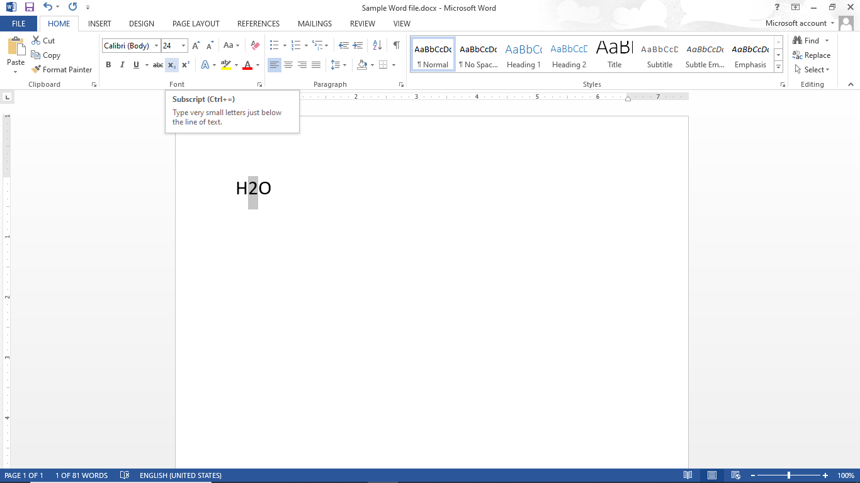
Home Tab – Font Group
Steps to Subscript and Superscript text:
Select that data for subscript by using mouse cursor or Shift + up/down/left/right arrow key.
Click on Subscript.

Slide 53
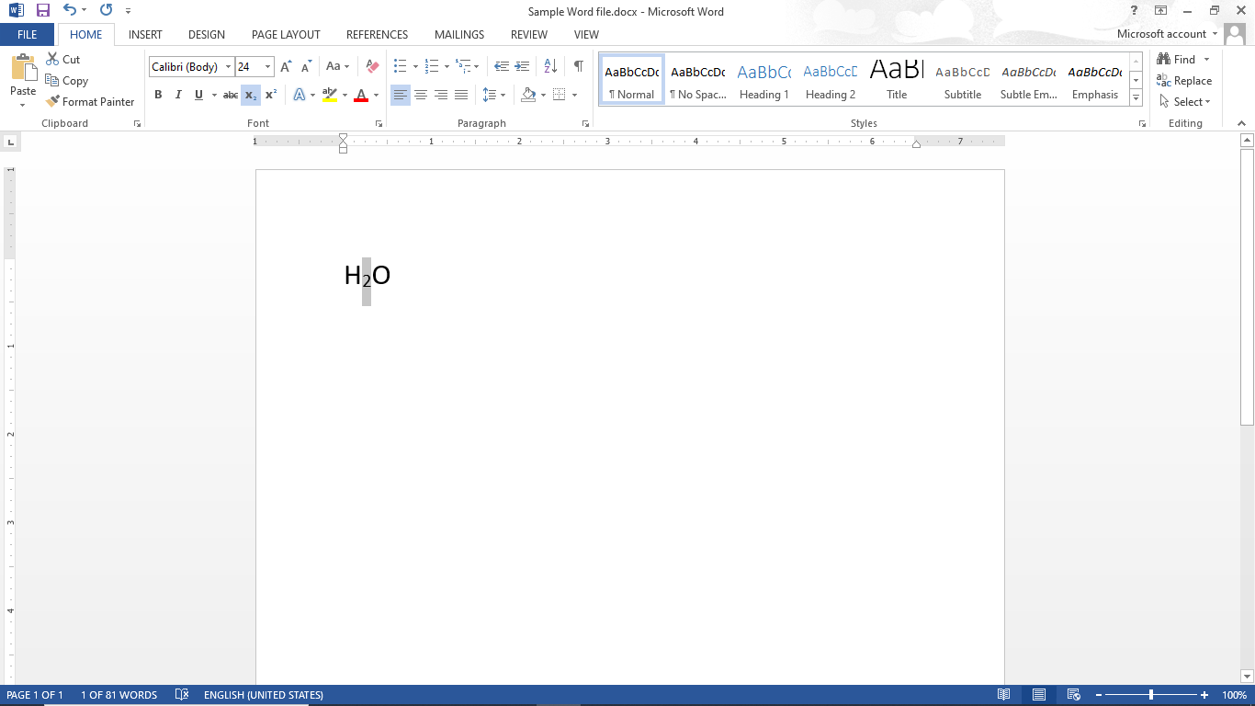
Home Tab – Font Group
Steps to Subscript and Superscript text:
Select that data for subscript by using mouse cursor or Shift + up/down/left/right arrow key.
Click on Subscript.

Slide 54

Home Tab – Font Group
Steps to Subscript and Superscript text:
Select that data for subscript by using mouse cursor or Shift + up/down/left/right arrow key.
Click on Subscript.
Select that data for superscript by using mouse cursor or Shift + up/down/left/right arrow key.

Slide 55
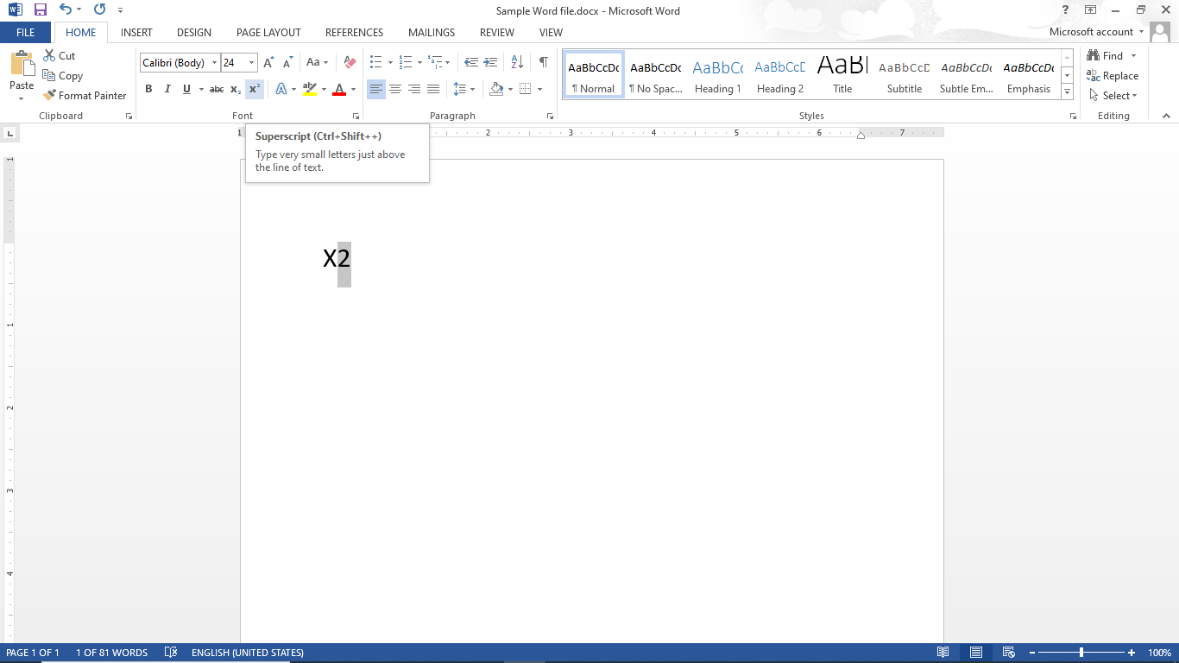
Home Tab – Font Group
Steps to Subscript and Superscript text:
Select that data for subscript by using mouse cursor or Shift + up/down/left/right arrow key.
Click on Subscript.
Select that data for superscript by using mouse cursor or Shift + up/down/left/right arrow key.
Click on Superscript.

Slide 56
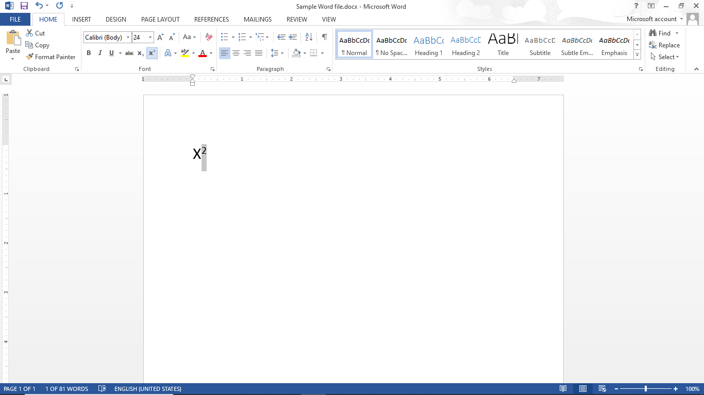
Home Tab – Font Group
Steps to Subscript and Superscript text:
Select that data for subscript by using mouse cursor or Shift + up/down/left/right arrow key.
Click on Subscript.
Select that data for superscript by using mouse cursor or Shift + up/down/left/right arrow key.
Click on Superscript.

Slide 57
Steps to change font and font size
Steps to change Case
Steps to change Font Color of the text
Steps to Bold / Italic / Underline / Strikethrough the text
Steps to Subscript and Superscript the text
Steps to Highlight text and to give Text Effects & Typography
Steps to Clear All Formatting
Home Tab - Font Group

Slide 58
Home Tab – Font Group
Steps to change Font Color of the text:
Select that data by using mouse cursor or Shift + up/down arrow key or Ctrl + a.

Slide 59
Home Tab – Font Group
Steps to change Font Color of the text:
Select that data by using mouse cursor or Shift + up/down arrow key or Ctrl + a.
Go to the Font group in Home Tab.

Slide 60
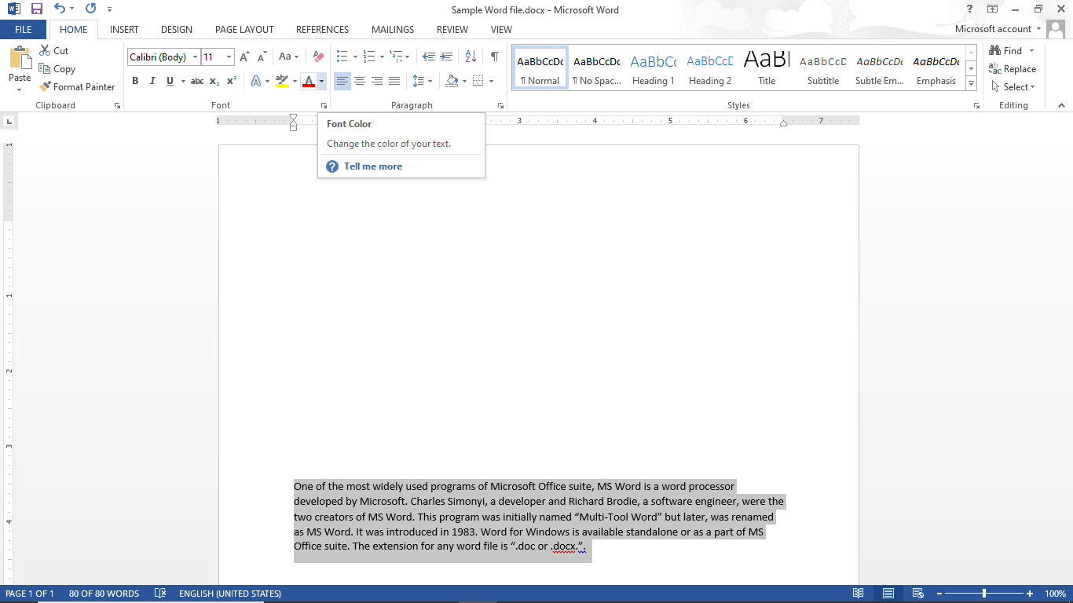
Home Tab – Font Group
Steps to change Font Color of the text:
Select that data by using mouse cursor or Shift + up/down arrow key or Ctrl + a.
Go to the Font group in Home Tab.
Select Font Color, to change the color of the font.

Slide 61
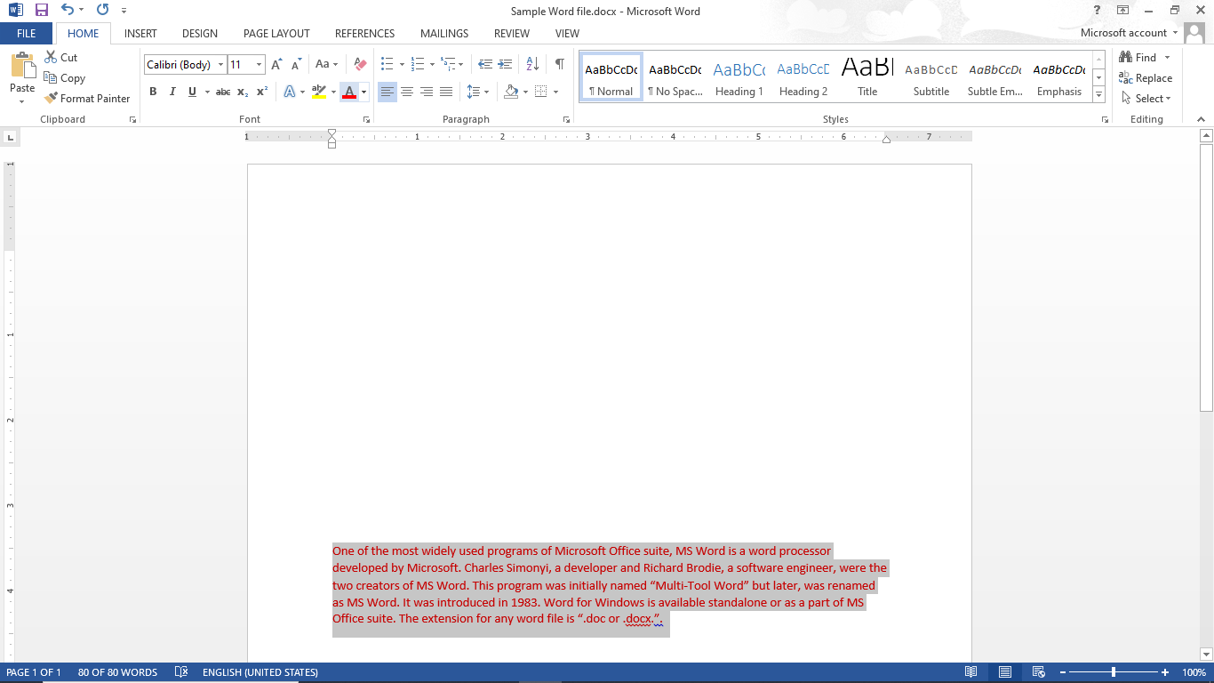
Home Tab – Font Group
Steps to change Font Color of the text:
Select that data by using mouse cursor or Shift + up/down arrow key or Ctrl + a.
Go to the Font group in Home Tab.
Select Font Color, to change the color of the font.

Slide 62
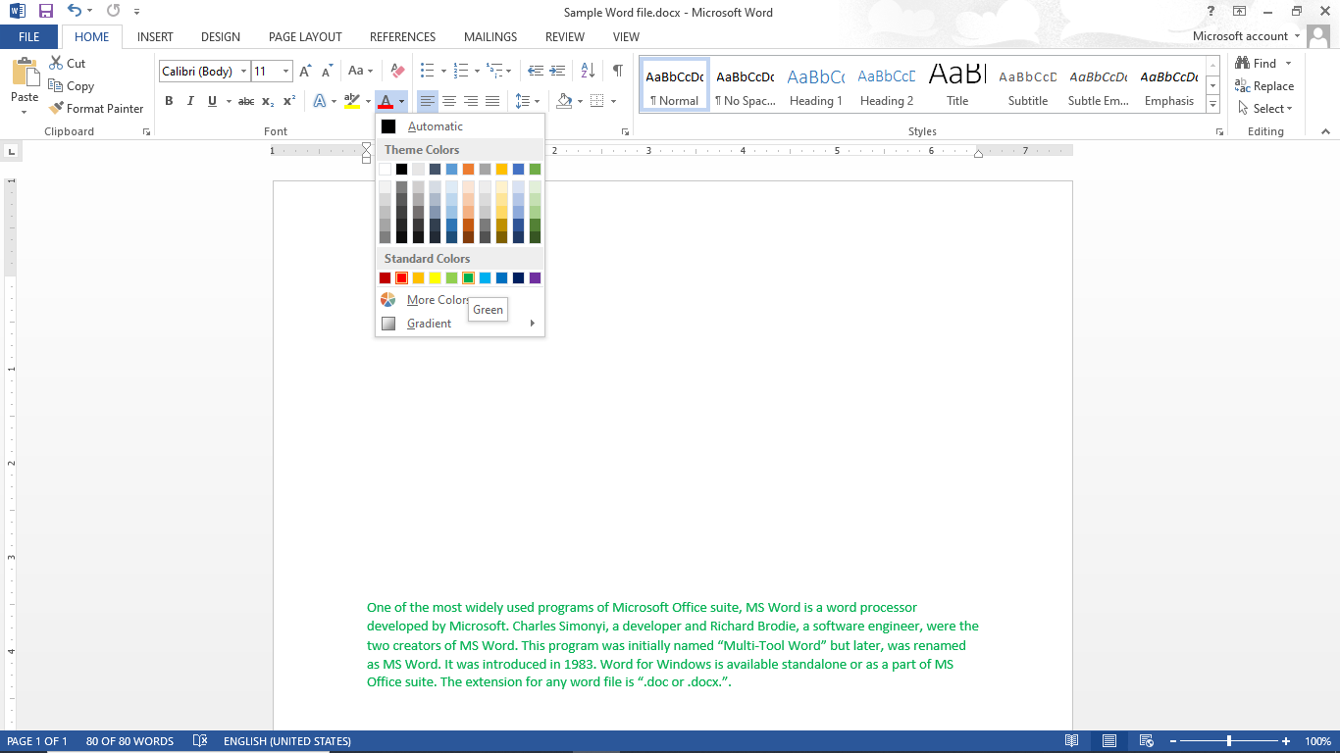
Home Tab – Font Group
Steps to change Font Color of the text:
Select that data by using mouse cursor or Shift + up/down arrow key or Ctrl + a.
Go to the Font group in Home Tab.
Select Font Color, to change the color of the font.
Click on Font Color drop down for more colors.

Slide 63
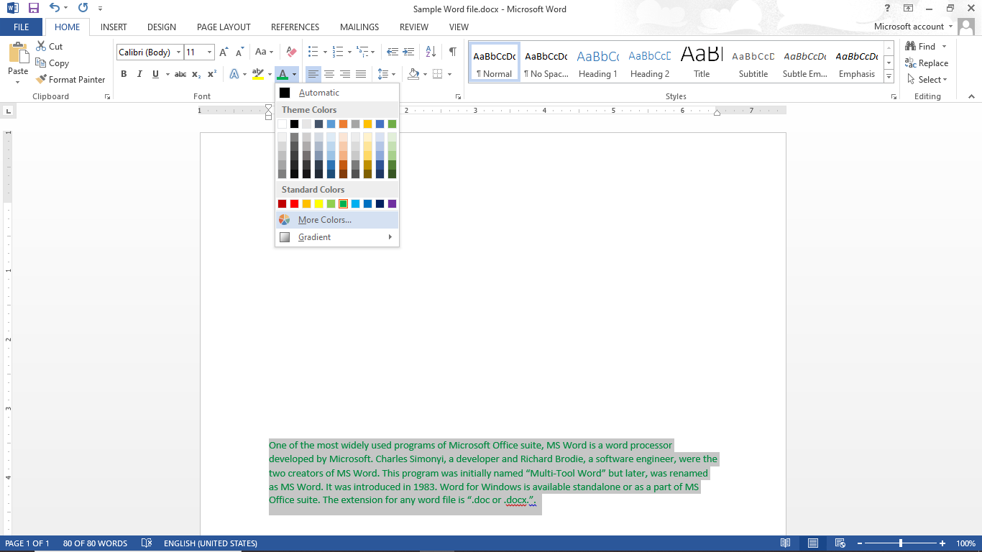
Home Tab – Font Group
Steps to change Font Color of the text:
Select that data by using mouse cursor or Shift + up/down arrow key or Ctrl + a.
Go to the Font group in Home Tab.
Select Font Color, to change the color of the font.
Click on Font Color drop down for more colors.

Slide 64
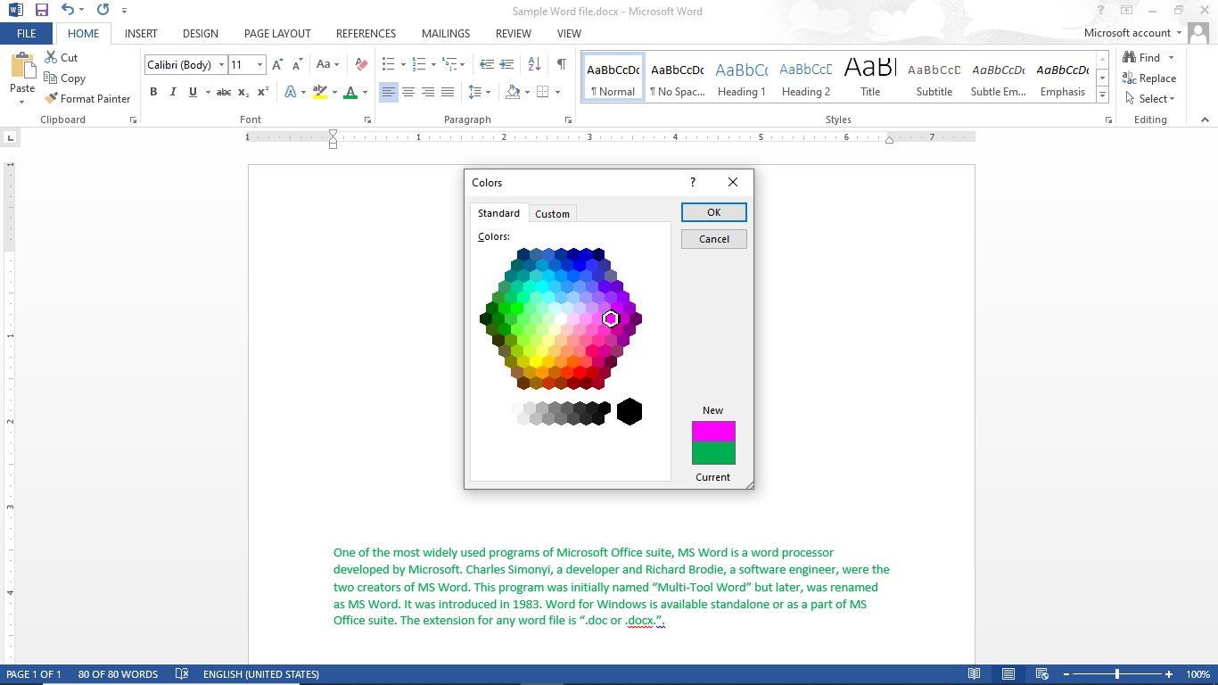
Home Tab – Font Group
Steps to change Font Color of the text:
Select that data by using mouse cursor or Shift + up/down arrow key or Ctrl + a.
Go to the Font group in Home Tab.
Select Font Color, to change the color of the font.
Click on Font Color drop down for more colors.

Slide 65
Home Tab – Font Group
Steps to change Font Color of the text:
Select that data by using mouse cursor or Shift + up/down arrow key or Ctrl + a.
Go to the Font group in Home Tab.
Select Font Color, to change the color of the font.
Click on Font Color drop down for more colors.

Slide 66
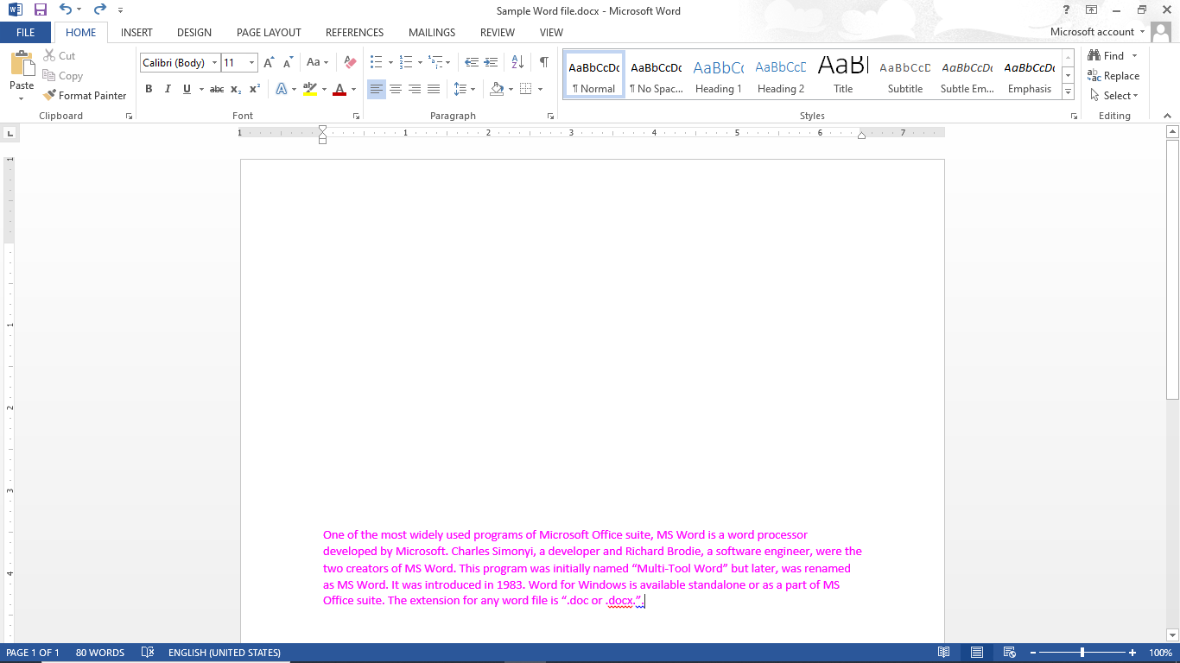
Home Tab – Font Group
Steps to change Font Color of the text:
Select that data by using mouse cursor or Shift + up/down arrow key or Ctrl + a.
Go to the Font group in Home Tab.
Select Font Color, to change the color of the font.
Click on Font Color drop down for more colors.

Slide 67
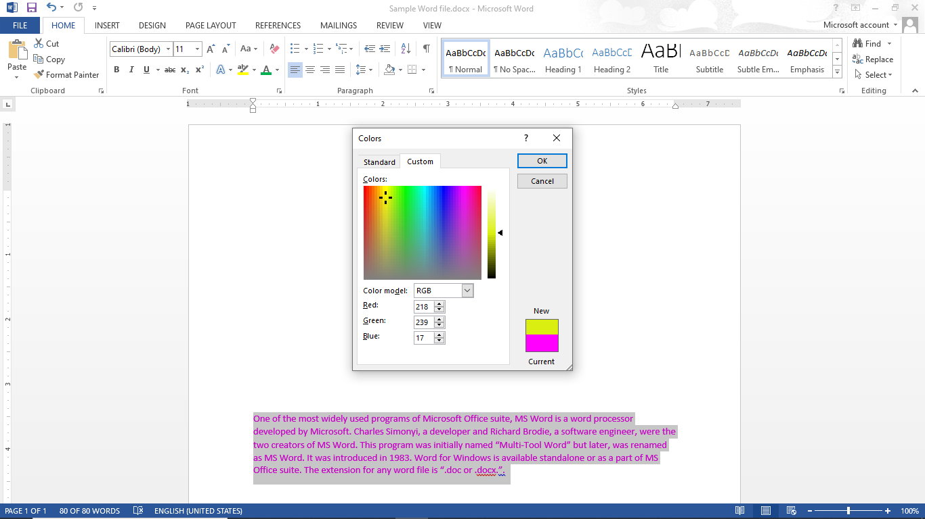
Home Tab – Font Group
Steps to change Font Color of the text:
Select that data by using mouse cursor or Shift + up/down arrow key or Ctrl + a.
Go to the Font group in Home Tab.
Select Font Color, to change the color of the font.
Click on Font Color drop down for more colors.

Slide 68
Home Tab – Font Group
Steps to change Font Color of the text:
Select that data by using mouse cursor or Shift + up/down arrow key or Ctrl + a.
Go to the Font group in Home Tab.
Select Font Color, to change the color of the font.
Click on Font Color drop down for more colors.

Slide 69
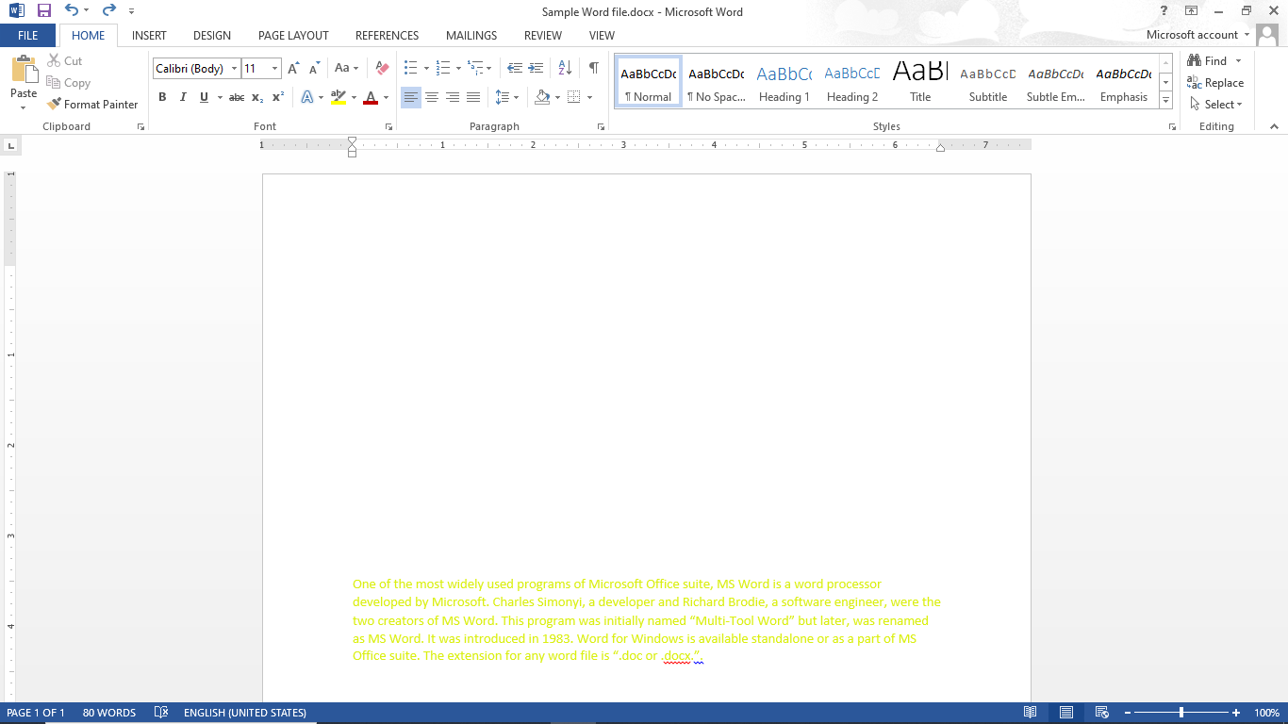
Home Tab – Font Group
Steps to change Font Color of the text:
Select that data by using mouse cursor or Shift + up/down arrow key or Ctrl + a.
Go to the Font group in Home Tab.
Select Font Color, to change the color of the font.
Click on Font Color drop down for more colors.

Slide 70
Steps to change font and font size
Steps to change Case
Steps to change Font Color of the text
Steps to Bold / Italic / Underline / Strikethrough the text
Steps to Subscript and Superscript the text
Steps to Highlight text and to give Text Effects & Typography
Steps to Clear All Formatting
Home Tab - Font Group

Slide 71
Home Tab – Font Group
Steps to Highlight text and to give Text Effects & Typography:
Select that data by using mouse cursor or Shift + up/down arrow key or Ctrl + a.

Slide 72
Home Tab – Font Group
Steps to Highlight text and to give Text Effects & Typography:
Select that data by using mouse cursor or Shift + up/down arrow key or Ctrl + a.
Go to the Font group in Home Tab.

Slide 73
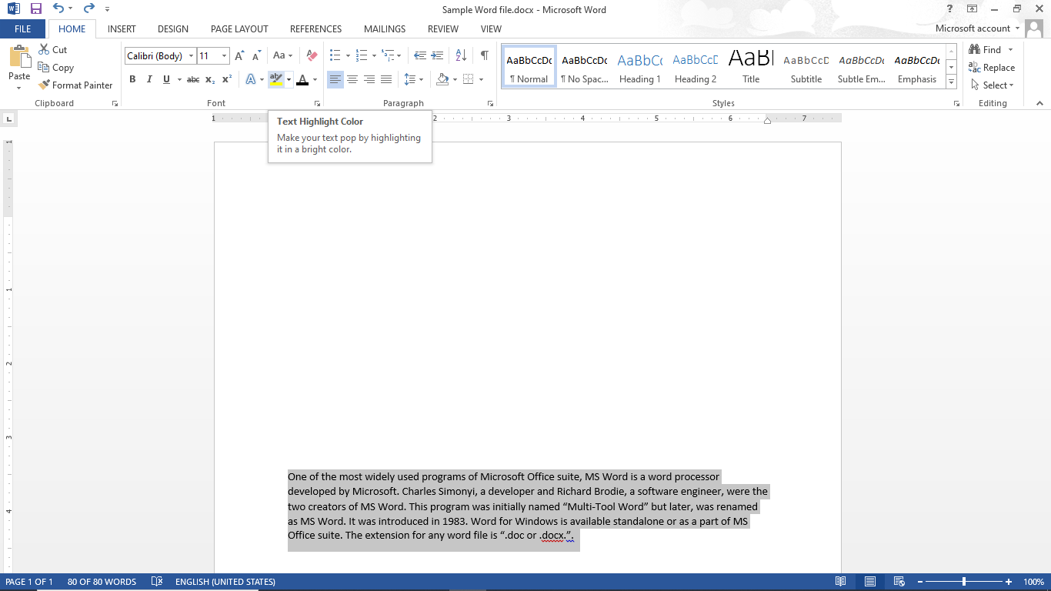
Home Tab – Font Group
Steps to Highlight text and to give Text Effects & Typography:
Select that data by using mouse cursor or Shift + up/down arrow key or Ctrl + a.
Go to the Font group in Home Tab.
Select Text Highlight Color to highlight the text.

Slide 74
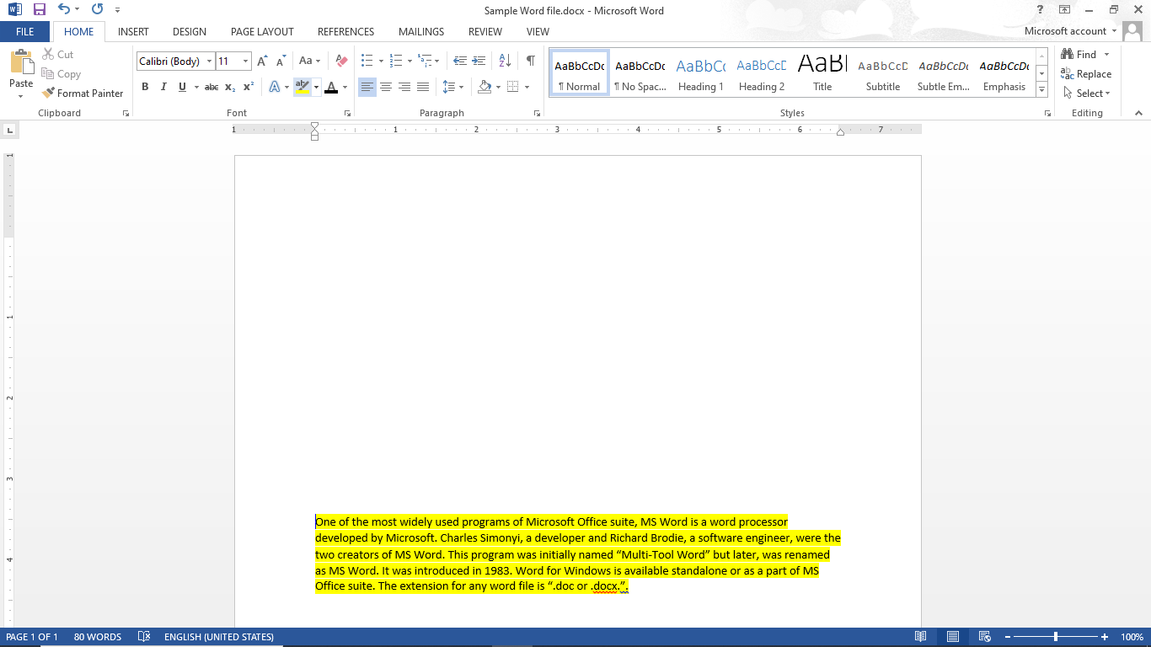
Home Tab – Font Group
Steps to Highlight text and to give Text Effects & Typography:
Select that data by using mouse cursor or Shift + up/down arrow key or Ctrl + a.
Go to the Font group in Home Tab.
Select Text Highlight Color to highlight the text.

Slide 75
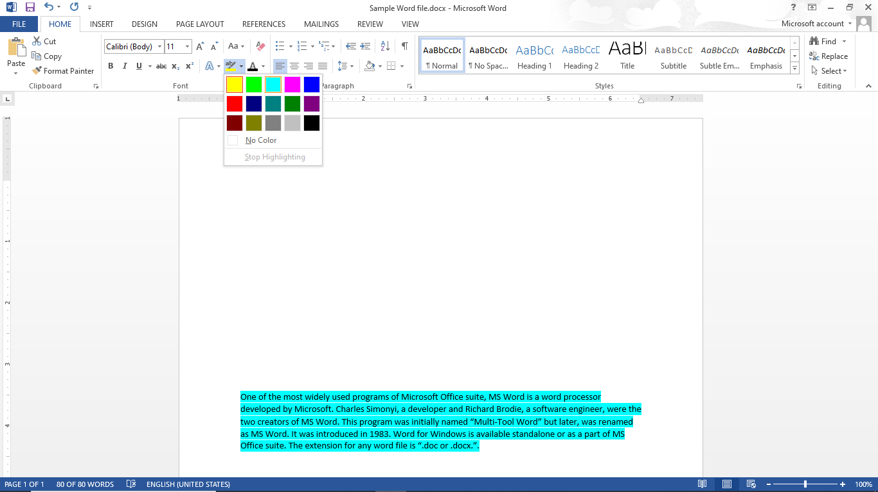
Home Tab – Font Group
Steps to Highlight text and to give Text Effects & Typography:
Select that data by using mouse cursor or Shift + up/down arrow key or Ctrl + a.
Go to the Font group in Home Tab.
Select Text Highlight Color to highlight the text.
Click on drop down of Text Highlight Color for more colors.

Slide 76
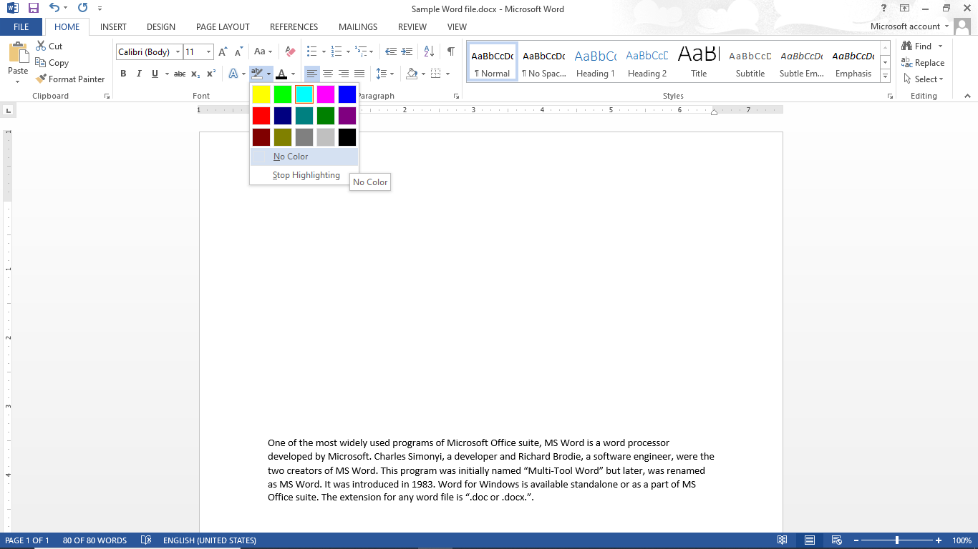
Home Tab – Font Group
Steps to Highlight text and to give Text Effects & Typography:
Select that data by using mouse cursor or Shift + up/down arrow key or Ctrl + a.
Go to the Font group in Home Tab.
Select Text Highlight Color to highlight the text.
Click on drop down of Text Highlight Color for more colors.

Slide 77
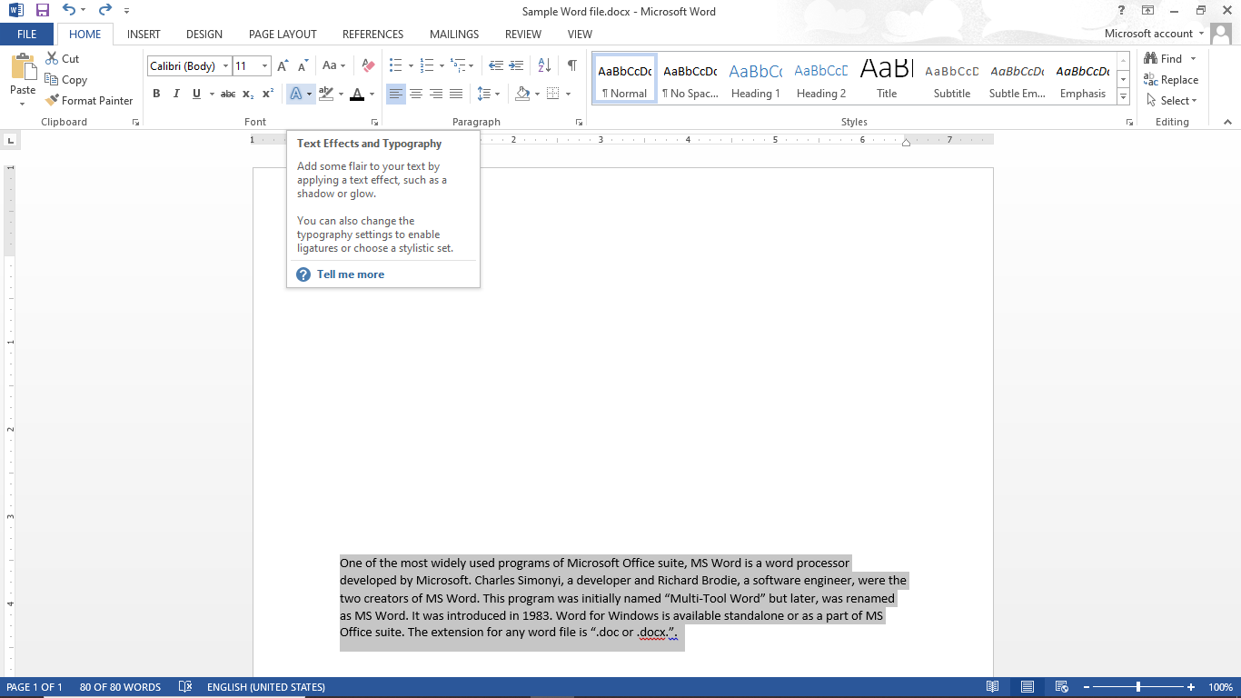
Home Tab – Font Group
Steps to Highlight text and to give Text Effects & Typography:
Select that data by using mouse cursor or Shift + up/down arrow key or Ctrl + a.
Go to the Font group in Home Tab.
Select Text Effects and Typography to give effects on the text.

Slide 78

Home Tab – Font Group
Steps to Highlight text and to give Text Effects & Typography:
Select that data by using mouse cursor or Shift + up/down arrow key or Ctrl + a.
Go to the Font group in Home Tab.
Select Text Effects and Typography to give effects on the text.

Slide 79

Home Tab – Font Group
Steps to Highlight text and to give Text Effects & Typography:
Select that data by using mouse cursor or Shift + up/down arrow key or Ctrl + a.
Go to the Font group in Home Tab.
Select Text Effects and Typography to give effects on the text.

Slide 80
Steps to change font and font size
Steps to change Case
Steps to change Font Color of the text
Steps to Bold / Italic / Underline / Strikethrough the text
Steps to Subscript and Superscript the text
Steps to Highlight text and to give Text Effects & Typography
Steps to Clear All Formatting
Home Tab - Font Group

Slide 81

Home Tab – Font Group
Steps to Clear All Formatting:
Select that data by using mouse cursor or Shift + up/down arrow key or Ctrl + a.

Slide 82
Home Tab – Font Group
Steps to Clear All Formatting:
Select that data by using mouse cursor or Shift + up/down arrow key or Ctrl + a.
Go to the Font group in Home Tab.

Slide 83

Home Tab – Font Group
Steps to Clear All Formatting:
Select that data by using mouse cursor or Shift + up/down arrow key or Ctrl + a.
Go to the Font group in Home Tab.
Click on Clear All Formatting to clear all the formatting.

Slide 84

Home Tab – Font Group
Steps to Clear All Formatting:
Select that data by using mouse cursor or Shift + up/down arrow key or Ctrl + a.
Go to the Font group in Home Tab.
Click on Clear All Formatting to clear all the formatting.

Slide 85
Home Tab – Clipboard Group
Steps to Cut, Copy and Paste the text
Steps to Format Painter the text

Slide 86
Home Tab – Clipboard Group
Steps to Cut, Copy, Paste the text:
Select that data by using mouse cursor or Shift + up/down arrow key or Ctrl + a.

Slide 87
Home Tab – Clipboard Group
Steps to Cut, Copy, Paste the text:
Select that data by using mouse cursor or Shift + up/down arrow key or Ctrl + a.
Go to the Clipboard group in Home Tab.

Slide 88

Home Tab – Clipboard Group
Steps to Cut, Copy, Paste the text:
Select that data by using mouse cursor or Shift + up/down arrow key or Ctrl + a.
Go to the Clipboard group in Home Tab.
Click on Cut to cut the text.

Slide 89

Home Tab – Clipboard Group
Steps to Cut, Copy, Paste the text:
Select that data by using mouse cursor or Shift + up/down arrow key or Ctrl + a.
Go to the Clipboard group in Home Tab.
Click on Cut to cut the text.

Slide 90

Home Tab – Clipboard Group
Steps to Cut, Copy, Paste the text:
Select that data by using mouse cursor or Shift + up/down arrow key or Ctrl + a.
Go to the Clipboard group in Home Tab.
Click on Cut to cut the text.
Click on Paste to paste the text where cursor is kept.

Slide 91

Home Tab – Clipboard Group
Steps to Cut, Copy, Paste the text:
Select that data by using mouse cursor or Shift + up/down arrow key or Ctrl + a.
Go to the Clipboard group in Home Tab.
Click on Cut to cut the text.
Click on Paste to paste the text where cursor is kept.

Slide 92

Home Tab – Clipboard Group
Steps to Cut, Copy, Paste the text:
Select that data by using mouse cursor or Shift + up/down arrow key or Ctrl + a.
Go to the Clipboard group in Home Tab.
Click on Cut to cut the text.
Click on Paste to paste the text where cursor is kept.
Click on Copy to copy and then click on Paste.

Slide 93

Home Tab – Clipboard Group
Steps to Cut, Copy, Paste the text:
Select that data by using mouse cursor or Shift + up/down arrow key or Ctrl + a.
Go to the Clipboard group in Home Tab.
Click on Cut to cut the text.
Click on Paste to paste the text where cursor is kept.
Click on Copy to copy and then click on Paste.

Slide 94

Home Tab – Clipboard Group
Steps to Cut, Copy, Paste the text:
Select that data by using mouse cursor or Shift + up/down arrow key or Ctrl + a.
Go to the Clipboard group in Home Tab.
Click on Cut to cut the text.
Click on Paste to paste the text where cursor is kept.
Click on Copy to copy and then click on Paste.

Slide 95
Home Tab – Clipboard Group
Steps to Cut, Copy and Paste the text
Steps to Format Painter the text

Slide 96

Home Tab – Clipboard Group
Steps to Format Painter the text:
Here, to set below text as per the format in the first line, use format painter instead of doing Bold, Italic and Font size increase separately.

Slide 97

Home Tab – Clipboard Group
Steps to Format Painter the text:
Here, to set below text as per the format in the first line, use format painter instead of doing Bold, Italic and Font size increase separately.
Select that data and go to the Clipboard group in Home Tab.

Slide 98

Home Tab – Clipboard Group
Steps to Format Painter the text:
Here, to set below text as per the format in the first line, use format painter instead of doing Bold, Italic and Font size increase separately.
Select that data and go to the Clipboard group in Home Tab.
Click on Format Painter. A brush like cursor will appear.

Slide 99

Home Tab – Clipboard Group
Steps to Format Painter the text:
Here, to set below text as per the format in the first line, use format painter instead of doing Bold, Italic and Font size increase separately.
Select that data and go to the Clipboard group in Home Tab.
Click on Format Painter. A brush like cursor will appear.
Move this brush to get same format for desired text.

Slide 100

Home Tab – Clipboard Group
Steps to Format Painter the text:
Here, to set below text as per the format in the first line, use format painter instead of doing Bold, Italic and Font size increase separately.
Select that data and go to the Clipboard group in Home Tab.
Click on Format Painter. A brush like cursor will appear.
Move this brush to get same format for desired text.

Slide 101
Steps to Align the text
Steps to set Bullets / Numbering the text
Steps to set Line Spacing
Steps to set Shading and Borders
Steps to Increase / Decrease Indent
Steps to Sort the text
Home Tab – Paragraph Group

Slide 102

Home Tab – Paragraph Group
Steps to Align the text:
For text alignment, go to Paragraph group in Home Tab.

Slide 103

Home Tab – Paragraph Group
Steps to Align the text:
For text alignment, go to Paragraph group in Home Tab.
Here, the given text is already left aligned.

Slide 104

Home Tab – Paragraph Group
Steps to Align the text:
For text alignment, go to Paragraph group in Home Tab.
Here, the given text is already left aligned.
Select the text and click on Center to align text in Center.

Slide 105

Home Tab – Paragraph Group
Steps to Align the text:
For text alignment, go to Paragraph group in Home Tab.
Here, the given text is already left aligned.
Select the text and click on Center to align text in Center.
Click on Align Right to align text on right side.

Slide 106

Home Tab – Paragraph Group
Steps to Align the text:
For text alignment, go to Paragraph group in Home Tab.
Here, the given text is already left aligned.
Select the text and click on Center to align text in Center.
Click on Align Right to align text on right side.
Click on Justify to distribute text evenly between the margins.

Slide 107
Steps to Align the text
Steps to set Bullets / Numbering the text
Steps to set Line Spacing
Steps to set Shading and Borders
Steps to Increase / Decrease Indent
Steps to Sort the text
Home Tab – Paragraph Group

Slide 108

Home Tab – Paragraph Group
Steps to set Bullets / Numbering the text:
To set Bullets / Numbering, go to Paragraph group in Home Tab.

Slide 109

Home Tab – Paragraph Group
Steps to set Bullets / Numbering the text:
To set Bullets / Numbering, go to Paragraph group in Home Tab.
Select the text and click on Bullets Drop Down / Numbering Drop down to set desired bullets / Numbering. (By default bullets / Numbering is set as None).

Slide 110

Home Tab – Paragraph Group
Steps to set Bullets / Numbering the text:
To set Bullets / Numbering, go to Paragraph group in Home Tab.
Select the text and click on Bullets Drop Down / Numbering Drop down to set desired bullets / Numbering. (By default bullets / Numbering is set as None).

Slide 111

Home Tab – Paragraph Group
Steps to set Bullets / Numbering the text:
To set Bullets / Numbering, go to Paragraph group in Home Tab.
Select the text and click on Bullets Drop Down / Numbering Drop down to set desired bullets / Numbering. (By default bullets / Numbering is set as None).

Slide 112

Home Tab – Paragraph Group
Steps to set Bullets / Numbering the text:
To set Bullets / Numbering, go to Paragraph group in Home Tab.
Select the text and click on Bullets Drop Down / Numbering Drop down to set desired bullets / Numbering. (By default bullets / Numbering is set as None).

Slide 113

Home Tab – Paragraph Group
Steps to set Bullets / Numbering the text:
To set Bullets / Numbering, go to Paragraph group in Home Tab.
Select the text and click on Bullets Drop Down / Numbering Drop down to set desired bullets / Numbering. (By default bullets / Numbering is set as None).

Slide 114

Home Tab – Paragraph Group
Steps to set Bullets / Numbering the text:
To set Bullets / Numbering, go to Paragraph group in Home Tab.
Select the text and click on Bullets Drop Down / Numbering Drop down to set desired bullets / Numbering. (By default bullets / Numbering is set as None).

Slide 115
Steps to Align the text
Steps to set Bullets / Numbering the text
Steps to set Line Spacing
Steps to set Shading and Borders
Steps to Increase / Decrease Indent
Steps to Sort the text
Home Tab – Paragraph Group

Slide 116
Home Tab – Paragraph Group
Steps to set Line Spacing:
To set Line Spacing between text, go to Paragraph group in Home Tab.

Slide 117

Home Tab – Paragraph Group
Steps to set Line Spacing:
To set Line Spacing between text, go to Paragraph group in Home Tab.
Click on Line spacing and set desired spacing between the lines.

Slide 118

Home Tab – Paragraph Group
Steps to set Line Spacing:
To set Line Spacing between text, go to Paragraph group in Home Tab.
Click on Line spacing and set desired spacing between the lines.

Slide 119

Home Tab – Paragraph Group
Steps to set Line Spacing:
To set Line Spacing between text, go to Paragraph group in Home Tab.
Click on Line spacing and set desired spacing between the lines.

Slide 120
Steps to Align the text
Steps to set Bullets / Numbering the text
Steps to set Line Spacing
Steps to set Shading and Borders
Steps to Increase / Decrease Indent
Steps to Sort the text
Home Tab – Paragraph Group

Slide 121
Home Tab – Paragraph Group
Steps to set Shading and Borders:
To set shading and borders, go to Paragraph group in Home Tab.

Slide 122

Home Tab – Paragraph Group
Steps to set Shading and Borders:
To set shading and borders, go to Paragraph group in Home Tab.
Click on Shading and choose desired color for the text. (By default, there is No Color option is chosen)

Slide 123

Home Tab – Paragraph Group
Steps to set Shading and Borders:
To set shading and borders, go to Paragraph group in Home Tab.
Click on Shading and choose desired color for the text. (By default, there is No Color option is chosen)

Slide 124

Home Tab – Paragraph Group
Steps to set Shading and Borders:
To set shading and borders, go to Paragraph group in Home Tab.
Click on Shading and choose desired color for the text. (By default, there is No Color option is chosen)

Slide 125

Home Tab – Paragraph Group
Steps to set Shading and Borders:
To set shading and borders, go to Paragraph group in Home Tab.
Click on Shading and choose desired color for the text. (By default, there is No Color option is chosen)
Click on Borders to set border for the selected text.

Slide 126

Home Tab – Paragraph Group
Steps to set Shading and Borders:
To set shading and borders, go to Paragraph group in Home Tab.
Click on Shading and choose desired color for the text. (By default, there is No Color option is chosen)
Click on Borders to set border for the selected text.

Slide 127

Home Tab – Paragraph Group
Steps to set Shading and Borders:
To set shading and borders, go to Paragraph group in Home Tab.
Click on Shading and choose desired color for the text. (By default, there is No Color option is chosen)
Click on Borders to set border for the selected text.

Slide 128
Steps to Align the text
Steps to set Bullets / Numbering the text
Steps to set Line Spacing
Steps to set Shading and Borders
Steps to Increase / Decrease Indent
Steps to Sort the text
Home Tab – Paragraph Group

Slide 129
Home Tab – Paragraph Group
Steps to Increase / Decrease Indent:
To move text away from the margin or towards the margin, indent is used.
To set indent, go to Paragraph group in Home Tab.

Slide 130

Home Tab – Paragraph Group
Steps to Increase / Decrease Indent:
To move text away from the margin or towards the margin, indent is used.
To set indent, go to Paragraph group in Home Tab.
Click on Increase indent to move text farther away from the margin and vice versa.

Slide 131

Home Tab – Paragraph Group
Steps to Increase / Decrease Indent:
To move text away from the margin or towards the margin, indent is used.
To set indent, go to Paragraph group in Home Tab.
Click on Increase indent to move text farther away from the margin and vice versa.

Slide 132

Home Tab – Paragraph Group
Steps to Increase / Decrease Indent:
To move text away from the margin or towards the margin, indent is used.
To set indent, go to Paragraph group in Home Tab.
Click on Increase indent to move text farther away from the margin and vice versa.

Slide 133

Home Tab – Paragraph Group
Steps to Increase / Decrease Indent:
To move text away from the margin or towards the margin, indent is used.
To set indent, go to Paragraph group in Home Tab.
Click on Increase indent to move text farther away from the margin and vice versa.

Slide 134

Home Tab – Paragraph Group
Steps to Increase / Decrease Indent:
To move text away from the margin or towards the margin, indent is used.
To set indent, go to Paragraph group in Home Tab.
Click on Increase indent to move text farther away from the margin and vice versa.

Slide 135
Steps to Align the text
Steps to set Bullets / Numbering the text
Steps to set Line Spacing
Steps to set Shading and Borders
Steps to Increase / Decrease Indent
Steps to Sort the text
Home Tab – Paragraph Group

Slide 136
Home Tab – Paragraph Group
Steps to Sort the text:
To sort text, go to Paragraph group in Home Tab.

Slide 137

Home Tab – Paragraph Group
Steps to Sort the text:
To sort text, go to Paragraph group in Home Tab.
Click on Sort to sort text / Number / Date.

Slide 138

Home Tab – Paragraph Group
Steps to Sort the text:
To sort text, go to Paragraph group in Home Tab.
Click on Sort to sort text / Number / Date.

Slide 139

Home Tab – Paragraph Group
Steps to Sort the text:
To sort text, go to Paragraph group in Home Tab.
Click on Sort to sort text / Number / Date.

Slide 140
Home Tab – Editing Group
Steps to Find any text
Steps to Replace any text

Slide 141
Home Tab – Editing Group
Steps to Find any text:
To find any text, go to Editing group in Home Tab.

Slide 142

Home Tab – Editing Group
Steps to Find any text:
To find any text, go to Editing group in Home Tab.
Click on Find, left side one panel will appear.

Slide 143
Home Tab – Editing Group
Steps to Find any text:
To find any text, go to Editing group in Home Tab.
Click on Find, left side one panel will appear.
Here, write the text in Search Document to find any text.

Slide 144

Home Tab – Editing Group
Steps to Find any text:
To find any text, go to Editing group in Home Tab.
Click on Find, left side one panel will appear.
Here, write the text in Search Document to find any text.
The found text will be highlighted in the text as a result.

Slide 145
Home Tab – Editing Group
Steps to Find any text
Steps to Replace any text

Slide 146
Home Tab – Editing Group
Steps to Replace any text:
To replace any text, go to Editing group in Home Tab.

Slide 147

Home Tab – Editing Group
Steps to Find any text:
To find any text, go to Editing group in Home Tab.
Click on Replace, one dialog box will appear will appear.

Slide 148

Home Tab – Editing Group
Steps to Find any text:
To find any text, go to Editing group in Home Tab.
Click on Replace, one dialog box will appear will appear.

Slide 149

Home Tab – Editing Group
Steps to Find any text:
To find any text, go to Editing group in Home Tab.
Click on Replace, one dialog box will appear will appear.
Fill the values of Find What and Replace with and click on Replace All.

Slide 150

Home Tab – Editing Group
Steps to Find any text:
To find any text, go to Editing group in Home Tab.
Click on Replace, one dialog box will appear will appear.
Fill the values of Find What and Replace with and click on Replace All.
Click on Ok after the replacements.

Slide 151

Home Tab – Editing Group
Steps to Find any text:
To find any text, go to Editing group in Home Tab.
Click on Replace, one dialog box will appear will appear.
Fill the values of Find What and Replace with and click on Replace All.
Click on Ok after the replacements.
The replaced text is shown with highlighted color.

Slide 152
Styles and Content

Slide 153
Home Tab – Styles Group
Steps to apply Styles to the text
Steps to Create a Style for the text

Slide 154
Home Tab – Styles Group
Steps to apply Styles to the text:
To apply a style to the text, go to Styles group in Home Tab.

Slide 155
Home Tab – Styles Group
Steps to apply Styles to the text:
To apply a style to the text, go to Styles group in Home Tab.
Select anyone style as per the choice. (By default, Normal style is selected.)

Slide 156

Home Tab – Styles Group
Steps to apply Styles to the text:
To apply a style to the text, go to Styles group in Home Tab.
Select anyone style as per the choice. (By default, Normal style is selected.)

Slide 157

Home Tab – Styles Group
Steps to apply Styles to the text:
To apply a style to the text, go to Styles group in Home Tab.
Select anyone style as per the choice. (By default, Normal style is selected.)

Slide 158

Home Tab – Styles Group
Steps to apply Styles to the text:
To apply a style to the text, go to Styles group in Home Tab.
Select anyone style as per the choice. (By default, Normal style is selected.)

Slide 159
Home Tab – Styles Group
Steps to apply Styles to the text
Steps to Create a Style for the text

Slide 160
Home Tab – Styles Group
Steps to create a style for the text:
To create a style for the text, go to Styles group in Home Tab.
Click on More to get an option to create a style.

Slide 161

Home Tab – Styles Group
Steps to create a style for the text:
To create a style for the text, go to Styles group in Home Tab.
Click on More to get an option to create a style.
Click on Create a Style, to create a new style.

Slide 162

Home Tab – Styles Group
Steps to create a style for the text:
To create a style for the text, go to Styles group in Home Tab.
Click on More to get an option to create a style.
Click on Create a Style, to create a new style.
Give Style name and click on Modify.

Slide 163

Home Tab – Styles Group
Steps to create a style for the text:
To create a style for the text, go to Styles group in Home Tab.
Click on More to get an option to create a style.
Click on Create a Style, to create a new style.
Give Style name and click on Modify.
In this dialog box, set properties and formatting as per the need and click on Ok.

Slide 164

Home Tab – Styles Group
Steps to create a style for the text:
To create a style for the text, go to Styles group in Home Tab.
Click on More to get an option to create a style.
Click on Create a Style, to create a new style.
Give Style name and click on Modify.
In this dialog box, set properties and formatting as per the need and click on Ok.

Slide 165
Home Tab – Styles Group
Steps to create a style for the text:
To create a style for the text, go to Styles group in Home Tab.
Click on More to get an option to create a style.
Click on Create a Style, to create a new style.
Give Style name and click on Modify.
In this dialog box, set properties and formatting as per the need and click on Ok.

Slide 166

Home Tab – Styles Group
Steps to create a style for the text:
To create a style for the text, go to Styles group in Home Tab.
Click on More to get an option to create a style.
Click on Create a Style, to create a new style.
Give Style name and click on Modify.
In this dialog box, set properties and formatting as per the need and click on Ok.
Now, the Style1 is visible in Styles.

Slide 167

Home Tab – Styles Group
Steps to create a style for the text:
To create a style for the text, go to Styles group in Home Tab.
Click on More to get an option to create a style.
Click on Create a Style, to create a new style.
Give Style name and click on Modify.
In this dialog box, set properties and formatting as per the need and click on Ok.
Now, the Style1 is visible in Styles.
Select the text and click on Style1 from Styles.

Slide 168
Working with Objects

Slide 169
Insert Tab – Pages Group
Steps to create Cover Page
Steps to do Page Break
Steps to add Blank Page

Slide 170

Insert Tab – Pages Group
Steps to create Cover Page:
To create a cover page, go to Pages group in Insert Tab.

Slide 171

Insert Tab – Pages Group
Steps to create Cover Page:
To create a cover page, go to Pages group in Insert Tab.
Click on Cover Page and choose any one cover page.

Slide 172

Insert Tab – Pages Group
Steps to create Cover Page:
To create a cover page, go to Pages group in Insert Tab.
Click on Cover Page and choose any one cover page.

Slide 173

Insert Tab – Pages Group
Steps to create Cover Page:
To create a cover page, go to Pages group in Insert Tab.
Click on Cover Page and choose any one cover page.
Add required information on the cover page.

Slide 174

Insert Tab – Pages Group
Steps to create Cover Page:
To create a cover page, go to Pages group in Insert Tab.
Click on Cover Page and choose any one cover page.
Add required information on the cover page.

Slide 175
Insert Tab – Pages Group
Steps to create Cover Page
Steps to do Page Break
Steps to add Blank Page

Slide 176

Insert Tab – Pages Group
Steps to add Blank Page:
To add a blank page, go to Pages group in Insert Tab.

Slide 177

Insert Tab – Pages Group
Steps to add Blank Page:
To add a blank page, go to Pages group in Insert Tab.
Keep the cursor at any place from where to add a blank page and click on Blank Page.

Slide 178

Insert Tab – Pages Group
Steps to add Blank Page:
To add a blank page, go to Pages group in Insert Tab.
Keep the cursor at any place from where to add a blank page and click on Blank Page.
A blank page will be added above the cursor.

Slide 179
Insert Tab – Pages Group
Steps to create Cover Page
Steps to do Page Break
Steps to add Blank Page

Slide 180

Insert Tab – Pages Group
Steps to do Page Break:
To do a page break, go to Pages group in Insert Tab.

Slide 181

Insert Tab – Pages Group
Steps to do Page Break:
To do a page break, go to Pages group in Insert Tab.
Keep the cursor at any place from where to break the page and click on Page Break.

Slide 182

Insert Tab – Pages Group
Steps to do Page Break:
To do a page break, go to Pages group in Insert Tab.
Keep the cursor at any place from where to break the page and click on Page Break.
A new page will be started from the cursor.

Slide 183
Steps to add Pictures in a document
Steps to add Clipart in a document
Steps to add Shapes in a document
Steps to add SmartArt in a document
Steps to add Chart in a document
Steps to add Screenshot in a document
Insert Tab – Illustrations Group

Slide 184
Insert Tab – Illustrations Group
Steps to add Pictures in a document:
To add a picture in a document file, go to Illustrations group in Insert Tab.

Slide 185

Insert Tab – Illustrations Group
Steps to add Pictures in a document:
To add a picture in a document file, go to Illustrations group in Insert Tab.
Keep the cursor at any place to add picture in a file and click on Pictures.

Slide 186

Insert Tab – Illustrations Group
Steps to add Pictures in a document:
To add a picture in a document file, go to Illustrations group in Insert Tab.
Keep the cursor at any place to add picture in a file and click on Pictures.
Choose the picture from the appropriate location from this dialog box and click on Insert.

Slide 187

Insert Tab – Illustrations Group
Steps to add Pictures in a document:
To add a picture in a document file, go to Illustrations group in Insert Tab.
Keep the cursor at any place to add picture in a file and click on Pictures.
Choose the picture from the appropriate location from this dialog box and click on Insert.

Slide 188
Steps to add Pictures in a document
Steps to add Clipart in a document
Steps to add Shapes in a document
Steps to add SmartArt in a document
Steps to add Chart in a document
Steps to add Screenshot in a document
Insert Tab – Illustrations Group

Slide 189
Insert Tab – Illustrations Group
Steps to add Clipart in a document:
To add a clipart in a document file, go to Illustrations group in Insert Tab.

Slide 190

Insert Tab – Illustrations Group
Steps to add Clipart in a document:
To add a clipart in a document file, go to Illustrations group in Insert Tab.
Keep the cursor at any place to add clipart in a file and click on Online Pictures.

Slide 191

Insert Tab – Illustrations Group
Steps to add Clipart in a document:
To add a clipart in a document file, go to Illustrations group in Insert Tab.
Keep the cursor at any place to add clipart in a file and click on Online Pictures.
Write the name of the clipart in Bing Image Search textbox and press enter.

Slide 192

Insert Tab – Illustrations Group
Steps to add Clipart in a document:
To add a clipart in a document file, go to Illustrations group in Insert Tab.
Keep the cursor at any place to add clipart in a file and click on Online Pictures.
Write the name of the clipart in Bing Image Search textbox and press enter.
Related clipart images will be shown here. Click on anyone image and click on Insert.

Slide 193

Insert Tab – Illustrations Group
Steps to add Clipart in a document:
To add a clipart in a document file, go to Illustrations group in Insert Tab.
Keep the cursor at any place to add clipart in a file and click on Online Pictures.
Write the name of the clipart in Bing Image Search textbox and press enter.
Related clipart images will be shown here. Click on anyone image and click on Insert.
A clipart images is inserted successfully.

Slide 194
Steps to add Pictures in a document
Steps to add Clipart in a document
Steps to add Shapes in a document
Steps to add SmartArt in a document
Steps to add Chart in a document
Steps to add Screenshot in a document
Insert Tab – Illustrations Group

Slide 195
Insert Tab – Illustrations Group
Steps to add Shapes in a document:
To add a shapes in a document file, go to Illustrations group in Insert Tab.

Slide 196

Insert Tab – Illustrations Group
Steps to add Shapes in a document:
To add a shape in a document file, go to Illustrations group in Insert Tab.
Keep the cursor at any place to add shape in a file and click on Shapes.

Slide 197

Insert Tab – Illustrations Group
Steps to add Shapes in a document:
To add a shape in a document file, go to Illustrations group in Insert Tab.
Keep the cursor at any place to add shape in a file and click on Shapes.
Select any shape from the shapes and drag the shape on the workspace.

Slide 198

Insert Tab – Illustrations Group
Steps to add Shapes in a document:
To add a shape in a document file, go to Illustrations group in Insert Tab.
Keep the cursor at any place to add shape in a file and click on Shapes.
Select any shape from the shapes and drag the shape on the workspace.

Slide 199
Steps to add Pictures in a document
Steps to add Clipart in a document
Steps to add Shapes in a document
Steps to add SmartArt in a document
Steps to add Chart in a document
Steps to add Screenshot in a document
Insert Tab – Illustrations Group

Slide 200
Insert Tab – Illustrations Group
Steps to add SmartArt in a document:
To add a SmartArt in a document file, go to Illustrations group in Insert Tab.

Slide 201

Insert Tab – Illustrations Group
Steps to add SmartArt in a document:
To add a SmartArt in a document file, go to Illustrations group in Insert Tab.
Keep the cursor at any place to add SmartArt in a file and click on SmartArt.

Slide 202

Insert Tab – Illustrations Group
Steps to add SmartArt in a document:
To add a SmartArt in a document file, go to Illustrations group in Insert Tab.
Keep the cursor at any place to add SmartArt in a file and click on SmartArt.
One dialog box will appear to choose a SmartArt Graphic.
Choose anyone SmartArt and click on Ok.

Slide 203

Insert Tab – Illustrations Group
Steps to add SmartArt in a document:
To add a SmartArt in a document file, go to Illustrations group in Insert Tab.
Keep the cursor at any place to add SmartArt in a file and click on SmartArt.
One dialog box will appear to choose a SmartArt Graphic.
Choose anyone SmartArt and click on Ok.

Slide 204
Steps to add Pictures in a document
Steps to add Clipart in a document
Steps to add Shapes in a document
Steps to add SmartArt in a document
Steps to add Chart in a document
Steps to add Screenshot in a document
Insert Tab – Illustrations Group

Slide 205
Insert Tab – Illustrations Group
Steps to add Chart in a document:
To add a Chart in a document file, go to Illustrations group in Insert Tab.

Slide 206

Insert Tab – Illustrations Group
Steps to add Chart in a document:
To add a Chart in a document file, go to Illustrations group in Insert Tab.
Keep the cursor at any place to add Chart in a file and click on Chart.

Slide 207

Insert Tab – Illustrations Group
Steps to add Chart in a document:
To add a Chart in a document file, go to Illustrations group in Insert Tab.
Keep the cursor at any place to add Chart in a file and click on Chart.
One dialog box named Insert Chart will appear.
Choose anyone chart with any type of its layout and click on Ok.

Slide 208

Insert Tab – Illustrations Group
Steps to add Chart in a document:
To add a Chart in a document file, go to Illustrations group in Insert Tab.
Keep the cursor at any place to add Chart in a file and click on Chart.
One dialog box named Insert Chart will appear.
Choose anyone chart with any type of its layout and click on Ok.
Data can be added in the small excel shown here and according to that a chart will be prepared in the Word.

Slide 209
Steps to add Pictures in a document
Steps to add Clipart in a document
Steps to add Shapes in a document
Steps to add SmartArt in a document
Steps to add Chart in a document
Steps to add Screenshot in a document
Insert Tab – Illustrations Group

Slide 210
Insert Tab – Illustrations Group
Steps to add Screenshot in a document:
To add a screenshot in a document file, go to Illustrations group in Insert Tab.

Slide 211

Insert Tab – Illustrations Group
Steps to add Screenshot in a document:
To add a screenshot in a document file, go to Illustrations group in Insert Tab.
Keep the cursor at any place to add screenshot in a file and click on screenshot.

Slide 212

Insert Tab – Illustrations Group
Steps to add Screenshot in a document:
To add a screenshot in a document file, go to Illustrations group in Insert Tab.
Keep the cursor at any place to add screenshot in a file and click on screenshot.
Available windows will be appear here, click on Screen Clipping to take screenshot.

Slide 213

Insert Tab – Illustrations Group
Steps to add Screenshot in a document:
To add a screenshot in a document file, go to Illustrations group in Insert Tab.
Keep the cursor at any place to add screenshot in a file and click on screenshot.
Available windows will be appear here, click on Screen Clipping to take screenshot.

Slide 214
Insert Tab – Links Group
Steps to create Hyperlink in a document

Slide 215
Insert Tab – Links Group
Steps to create Hyperlink in a document:
To add a hyperlink in a document file, go to Links group in Insert Tab.

Slide 216

Insert Tab – Links Group
Steps to create Hyperlink in a document:
To add a hyperlink in a document file, go to Links group in Insert Tab.
Keep the cursor at any place to add hyperlink in a file and click on hyperlink.

Slide 217

Insert Tab – Links Group
Steps to create Hyperlink in a document:
To add a hyperlink in a document file, go to Links group in Insert Tab.
Keep the cursor at any place to add hyperlink in a file and click on hyperlink.
Choose a file from the location and click on Ok.

Slide 218

Insert Tab – Links Group
Steps to create Hyperlink in a document:
To add a hyperlink in a document file, go to Links group in Insert Tab.
Keep the cursor at any place to add hyperlink in a file and click on hyperlink.
Choose a file from the location and click on Ok.
A hyperlink will be available on the page.

Slide 219

Insert Tab – Links Group
Steps to create Hyperlink in a document:
To add a hyperlink in a document file, go to Links group in Insert Tab.
Keep the cursor at any place to add hyperlink in a file and click on hyperlink.
Choose a file from the location and click on Ok.
A hyperlink will be available on the page.
Press Click+Ctrl to open the link.

Slide 220

Insert Tab – Links Group
Steps to create Hyperlink in a document:
To add a hyperlink in a document file, go to Links group in Insert Tab.
Keep the cursor at any place to add hyperlink in a file and click on hyperlink.
Choose a file from the location and click on Ok.
A hyperlink will be available on the page.
Press Click+Ctrl to open the link.

Slide 221
Insert Tab – Header & Footer Group
Steps to add Header in a document
Steps to add Page Number in a document
Steps to add Footer in a document

Slide 222
Insert Tab – Header & Footer Group
Steps to add Header in a document:
To add a header in a document file, go to Header & Footer group in Insert Tab.

Slide 223

Insert Tab – Header & Footer Group
Steps to add Header in a document:
To add a header in a document file, go to Header & Footer group in Insert Tab.
Click on Header to add header in a document.

Slide 224

Insert Tab – Header & Footer Group
Steps to add Header in a document:
To add a header in a document file, go to Header & Footer group in Insert Tab.
Click on Header to add header in a document.
Select anyone header.

Slide 225

Insert Tab – Header & Footer Group
Steps to add Header in a document:
To add a header in a document file, go to Header & Footer group in Insert Tab.
Click on Header to add header in a document.
Select anyone header.
Here, any text can be written as a header.

Slide 226

Insert Tab – Header & Footer Group
Steps to add Header in a document:
To add a header in a document file, go to Header & Footer group in Insert Tab.
Click on Header to add header in a document.
Select anyone header.
Here, any text can be written as a header.

Slide 227
Insert Tab – Header & Footer Group
Steps to add Header in a document
Steps to add Page Number in a document
Steps to add Footer in a document

Slide 228
Insert Tab – Header & Footer Group
Steps to add Footer in a document:
To add a footer in a document file, go to Header & Footer group in Insert Tab.

Slide 229

Insert Tab – Header & Footer Group
Steps to add Footer in a document:
To add a footer in a document file, go to Header & Footer group in Insert Tab.
Click on footer to add footer in a document.

Slide 230

Insert Tab – Header & Footer Group
Steps to add Footer in a document:
To add a footer in a document file, go to Header & Footer group in Insert Tab.
Click on footer to add footer in a document.
Select anyone footer.

Slide 231

Insert Tab – Header & Footer Group
Steps to add Footer in a document:
To add a footer in a document file, go to Header & Footer group in Insert Tab.
Click on footer to add footer in a document.
Select anyone footer.
Here, any text can be written as a footer.

Slide 232

Insert Tab – Header & Footer Group
Steps to add Footer in a document:
To add a footer in a document file, go to Header & Footer group in Insert Tab.
Click on footer to add footer in a document.
Select anyone footer.
Here, any text can be written as a footer.

Slide 233
Insert Tab – Header & Footer Group
Steps to add Header in a document
Steps to add Page Number in a document
Steps to add Footer in a document

Slide 234
Insert Tab – Header & Footer Group
Steps to add Page Number in a document:
To add a Page Number in a document file, go to Header & Footer group in Insert Tab.

Slide 235

Insert Tab – Header & Footer Group
Steps to add Page Number in a document:
To add a Page Number in a document file, go to Header & Footer group in Insert Tab.
Click on Page Numbers to add Page Number in a document.

Slide 236

Insert Tab – Header & Footer Group
Steps to add Page Number in a document:
To add a Page Number in a document file, go to Header & Footer group in Insert Tab.
Click on Page Numbers to add Page Number in a document.
Select anyone Page Number.

Slide 237

Insert Tab – Header & Footer Group
Steps to add Page Number in a document:
To add a Page Number in a document file, go to Header & Footer group in Insert Tab.
Click on Page Numbers to add Page Number in a document.
Select anyone Page Number.

Slide 238

Insert Tab – Header & Footer Group
Steps to add Page Number in a document:
To add a Page Number in a document file, go to Header & Footer group in Insert Tab.
Click on Page Numbers to add Page Number in a document.
Select anyone Page Number.

Slide 239
Insert Tab – Text Group
Steps to set Date & Time in a document
Steps to add Object in a document

Slide 240
Insert Tab – Text Group
Steps to set Date & Time in a document:
To set Date & Time in a document file, go to Text group in Insert Tab.

Slide 241

Insert Tab – Text Group
Steps to set Date & Time in a document:
To set Date & Time in a document file, go to Text group in Insert Tab.
Keep the cursor at any place to set Date & Time in a file and click on Date & Time.

Slide 242

Insert Tab – Text Group
Steps to set Date & Time in a document:
To set Date & Time in a document file, go to Text group in Insert Tab.
Keep the cursor at any place to set Date & Time in a file and click on Date & Time.
Choose any format and click on Ok.

Slide 243

Insert Tab – Text Group
Steps to set Date & Time in a document:
To set Date & Time in a document file, go to Text group in Insert Tab.
Keep the cursor at any place to set Date & Time in a file and click on Date & Time.
Choose any format and click on Ok.
The date is added in the document.

Slide 244
Insert Tab – Text Group
Steps to set Date & Time in a document
Steps to add Object in a document

Slide 245
Insert Tab – Text Group
Steps to add Object in a document:
To add Object in a document file, go to Text group in Insert Tab.

Slide 246

Insert Tab – Text Group
Steps to add Object in a document:
To add Object in a document file, go to Text group in Insert Tab.
Keep the cursor at any place to add Object in a file and click on Object.

Slide 247

Insert Tab – Text Group
Steps to add Object in a document:
To add Object in a document file, go to Text group in Insert Tab.
Keep the cursor at any place to add Object in a file and click on Object.
Select anyone from the given dialog box and click on Ok.

Slide 248

Insert Tab – Text Group
Steps to add Object in a document:
To add Object in a document file, go to Text group in Insert Tab.
Keep the cursor at any place to add Object in a file and click on Object.
Select anyone from the given dialog box and click on Ok.
Excel chart will appear on the screen.

Slide 249

Insert Tab – Text Group
Steps to add Object in a document:
To add Object in a document file, go to Text group in Insert Tab.
Keep the cursor at any place to add Object in a file and click on Object.
Select anyone from the given dialog box and click on Ok.
Excel chart will appear on the screen.
Data can also be manipulated from the excel sheet.

Slide 250

Insert Tab – Text Group
Steps to add Object in a document:
To add Object in a document file, go to Text group in Insert Tab.
Keep the cursor at any place to add Object in a file and click on Object.
Select anyone from the given dialog box and click on Ok.
Excel chart will appear on the screen.
Data can also be manipulated from the excel sheet.

Slide 251
Insert Tab – Symbols Group
Steps to add Equation in a document
Steps to add Symbol in a document

Slide 252
Insert Tab – Symbols Group
Steps to add Equation in a document:
To add Equation in a document file, go to Symbols group in Insert Tab.

Slide 253

Insert Tab – Symbols Group
Steps to add Equation in a document:
To add Equation in a document file, go to Symbols group in Insert Tab.
Keep the cursor at any place to add Equation in a file and click on Equation.

Slide 254

Insert Tab – Symbols Group
Steps to add Equation in a document:
To add Equation in a document file, go to Symbols group in Insert Tab.
Keep the cursor at any place to add Equation in a file and click on Equation.
The new Design tab will appear for equation structures.

Slide 255

Insert Tab – Symbols Group
Steps to add Equation in a document:
To add Equation in a document file, go to Symbols group in Insert Tab.
Keep the cursor at any place to add Equation in a file and click on Equation.
The new Design tab will appear for equation structures.
Select any one structure and write the value in it.

Slide 256

Insert Tab – Symbols Group
Steps to add Equation in a document:
To add Equation in a document file, go to Symbols group in Insert Tab.
Keep the cursor at any place to add Equation in a file and click on Equation.
The new Design tab will appear for equation structures.
Select any one structure and write the value in it.

Slide 257

Insert Tab – Symbols Group
Steps to add Equation in a document:
To add Equation in a document file, go to Symbols group in Insert Tab.
Keep the cursor at any place to add Equation in a file and click on Equation.
The new Design tab will appear for equation structures.
Select any one structure and write the value in it.

Slide 258
Insert Tab – Symbols Group
Steps to add Equation in a document
Steps to add Symbol in a document

Slide 259
Insert Tab – Symbols Group
Steps to add Symbol in a document:
To add Symbol in a document file, go to Symbols group in Insert Tab.

Slide 260

Insert Tab – Symbols Group
Steps to add Symbol in a document:
To add Symbol in a document file, go to Symbols group in Insert Tab.
Keep the cursor at any place to add Symbol in a file and click on Symbols.

Slide 261

Insert Tab – Symbols Group
Steps to add Symbol in a document:
To add Symbol in a document file, go to Symbols group in Insert Tab.
Keep the cursor at any place to add Symbol in a file and click on Symbols.
Select any symbol from the given box and click on More Symbols for other symbols.

Slide 262

Insert Tab – Symbols Group
Steps to add Symbol in a document:
To add Symbol in a document file, go to Symbols group in Insert Tab.
Keep the cursor at any place to add Symbol in a file and click on Symbols.
Select any symbol from the given box and click on More Symbols for other symbols.

Slide 263

Insert Tab – Symbols Group
Steps to add Symbol in a document:
To add Symbol in a document file, go to Symbols group in Insert Tab.
Keep the cursor at any place to add Symbol in a file and click on Symbols.
Select any symbol from the given box and click on More Symbols for other symbols.

Slide 264
Design

Slide 265
Steps to set Themes in a Document
Steps to change Colors of a Theme
Steps to change Fonts of a Theme
Steps to change Paragraph Spacing of a Theme
Steps to change Effects of a Theme
Steps to Set as Default a Theme
Design Tab – Document Formatting Group

Slide 266

Design Tab – Document Formatting Group
Steps to set Themes in a document:
To set theme in a document file, go to Document Formatting Group in Design Tab.

Slide 267

Design Tab – Document Formatting Group
Steps to set Themes in a document:
To set theme in a document file, go to Document Formatting Group in Design Tab.
Click on Themes, select anyone and changes can be seen on the page.

Slide 268

Design Tab – Document Formatting Group
Steps to set Themes in a document:
To set theme in a document file, go to Document Formatting Group in Design Tab.
Click on Themes, select anyone and changes can be seen on the page.

Slide 269

Design Tab – Document Formatting Group
Steps to set Themes in a document:
To set theme in a document file, go to Document Formatting Group in Design Tab.
Click on Themes, select anyone and changes can be seen on the page.

Slide 270

Design Tab – Document Formatting Group
Steps to set Themes in a document:
To set theme in a document file, go to Document Formatting Group in Design Tab.
Click on Themes, select anyone and changes can be seen on the page.
Document’s style set can also be changed.

Slide 271
Steps to set Themes in a Document
Steps to change Colors of a Theme
Steps to change Fonts of a Theme
Steps to change Paragraph Spacing of a Theme
Steps to change Effects of a Theme
Steps to Set as Default a Theme
Design Tab – Document Formatting Group

Slide 272
Design Tab – Document Formatting Group
Steps to change Colors of a Theme:
To change Colors of a Theme in a document file, go to Document Formatting Group in Design Tab.

Slide 273

Design Tab – Document Formatting Group
Steps to change Colors of a Theme:
To change Colors of a Theme in a document file, go to Document Formatting Group in Design Tab.
Give heading with Title style and sub-heading with Heading1 style from Home tab.

Slide 274

Design Tab – Document Formatting Group
Steps to change Colors of a Theme:
To change Colors of a Theme in a document file, go to Document Formatting Group in Design Tab.
Give heading with Title style and sub-heading with Heading1 style from Home tab.
Click on Colors, select anyone and changes can be seen on the page.

Slide 275

Design Tab – Document Formatting Group
Steps to change Colors of a Theme:
To change Colors of a Theme in a document file, go to Document Formatting Group in Design Tab.
Give heading with Title style and sub-heading with Heading1 style from Home tab.
Click on Colors, select anyone and changes can be seen on the page.

Slide 276

Design Tab – Document Formatting Group
Steps to change Colors of a Theme:
To change Colors of a Theme in a document file, go to Document Formatting Group in Design Tab.
Give heading with Title style and sub-heading with Heading1 style from Home tab.
Click on Colors, select anyone and changes can be seen on the page.

Slide 277
Steps to set Themes in a Document
Steps to change Colors of a Theme
Steps to change Fonts of a Theme
Steps to change Paragraph Spacing of a Theme
Steps to change Effects of a Theme
Steps to Set as Default a Theme
Design Tab – Document Formatting Group

Slide 278
Design Tab – Document Formatting Group
Steps to change Fonts of a Theme:
To change Fonts of a Theme in a document file, go to Document Formatting Group in Design Tab.

Slide 279

Design Tab – Document Formatting Group
Steps to change Fonts of a Theme:
To change Fonts of a Theme in a document file, go to Document Formatting Group in Design Tab.
Click on Fonts and choose anyone.

Slide 280

Design Tab – Document Formatting Group
Steps to change Fonts of a Theme:
To change Fonts of a Theme in a document file, go to Document Formatting Group in Design Tab.
Click on Fonts and choose anyone.

Slide 281
Steps to set Themes in a Document
Steps to change Colors of a Theme
Steps to change Fonts of a Theme
Steps to change Paragraph Spacing of a Theme
Steps to change Effects of a Theme
Steps to Set as Default a Theme
Design Tab – Document Formatting Group

Slide 282
Design Tab – Document Formatting Group
Steps to change Paragraph Spacing of a Theme:
To change Paragraph Spacing of a Theme in a document file, go to Document Formatting Group in Design Tab.

Slide 283

Design Tab – Document Formatting Group
Steps to change Paragraph Spacing of a Theme:
To change Paragraph Spacing of a Theme in a document file, go to Document Formatting Group in Design Tab.
Click on Paragraph Spacing and choose anyone.

Slide 284

Design Tab – Document Formatting Group
Steps to change Paragraph Spacing of a Theme:
To change Paragraph Spacing of a Theme in a document file, go to Document Formatting Group in Design Tab.
Click on Paragraph Spacing and choose anyone.

Slide 285
Steps to set Themes in a Document
Steps to change Colors of a Theme
Steps to change Fonts of a Theme
Steps to change Paragraph Spacing of a Theme
Steps to change Effects of a Theme
Steps to Set as Default a Theme
Design Tab – Document Formatting Group

Slide 286
Design Tab – Document Formatting Group
Steps to change Effects of a Theme:
To change Effects of a Theme in a document file, go to Document Formatting Group in Design Tab.

Slide 287

Design Tab – Document Formatting Group
Steps to change Effects of a Theme:
To change Effects of a Theme in a document file, go to Document Formatting Group in Design Tab.
Add a shape from the Insert tab.

Slide 288

Design Tab – Document Formatting Group
Steps to change Effects of a Theme:
To change Effects of a Theme in a document file, go to Document Formatting Group in Design Tab.
Add a shape from the Insert tab.
Click on Effects and select anyone.

Slide 289

Design Tab – Document Formatting Group
Steps to change Effects of a Theme:
To change Effects of a Theme in a document file, go to Document Formatting Group in Design Tab.
Add a shape from the Insert tab.
Click on Effects and select anyone.

Slide 290
Steps to set Themes in a Document
Steps to change Colors of a Theme
Steps to change Fonts of a Theme
Steps to change Paragraph Spacing of a Theme
Steps to change Effects of a Theme
Steps to Set as Default a Theme
Design Tab – Document Formatting Group

Slide 291
Design Tab – Document Formatting Group
Steps to Set as a Default Theme:
To Set as a Default Theme in a document file, go to Document Formatting Group in Design Tab.

Slide 292

Design Tab – Document Formatting Group
Steps to Set as a Default Theme:
To Set as a Default Theme in a document file, go to Document Formatting Group in Design Tab.
Click on Set as Default to set this theme for all future word documents.

Slide 293

Design Tab – Document Formatting Group
Steps to Set as a Default Theme:
To Set as a Default Theme in a document file, go to Document Formatting Group in Design Tab.
Click on Set as Default to set this theme for all future word documents.
Click on Yes.

Slide 294

Design Tab – Document Formatting Group
Steps to Set as a Default Theme:
To Set as a Default Theme in a document file, go to Document Formatting Group in Design Tab.
Click on Set as Default to set this theme for all future word documents.
Click on Yes.
Open a new word file to check the theme.

Slide 295
Design Tab – Page Background Group
Steps to add Watermark in a document
Steps to set Page Borders in a document
Steps to set Page Color in a document

Slide 296
Design Tab – Page Background Group
Steps to add Watermark in a document:
To add watermark in a document file, go to Page Background group in Design Tab.

Slide 297

Design Tab – Page Background Group
Steps to add Watermark in a document:
To add watermark in a document file, go to Page Background group in Design Tab.
Click on Watermark and select anyone.

Slide 298

Design Tab – Page Background Group
Steps to add Watermark in a document:
To add watermark in a document file, go to Page Background group in Design Tab.
Click on Watermark and select anyone.

Slide 299

Design Tab – Page Background Group
Steps to add Watermark in a document:
To add watermark in a document file, go to Page Background group in Design Tab.
Click on Watermark and select anyone.
Watermark will appear on the page.

Slide 300

Design Tab – Page Background Group
Steps to add Watermark in a document:
To add watermark in a document file, go to Page Background group in Design Tab.
Click on Watermark and select anyone.
Watermark will appear on the page.
To set custom watermark, go to Watermark and click on Custom Watermark.

Slide 301
Design Tab – Page Background Group
Steps to add Watermark in a document:
To add watermark in a document file, go to Page Background group in Design Tab.
Click on Watermark and select anyone.
Watermark will appear on the page.
To set custom watermark, go to Watermark and click on Custom Watermark.

Slide 302

Design Tab – Page Background Group
Steps to add Watermark in a document:
To add watermark in a document file, go to Page Background group in Design Tab.
Click on Watermark and select anyone.
Watermark will appear on the page.
To set custom watermark, go to Watermark and click on Custom Watermark.
Fill the data as per the requirement and click on ok.

Slide 303

Design Tab – Page Background Group
Steps to add Watermark in a document:
To add watermark in a document file, go to Page Background group in Design Tab.
Click on Watermark and select anyone.
Watermark will appear on the page.
To set custom watermark, go to Watermark and click on Custom Watermark.
Fill the data as per the requirement and click on ok.

Slide 304

Design Tab – Page Background Group
Steps to add Watermark in a document:
To add watermark in a document file, go to Page Background group in Design Tab.
Click on Watermark and select anyone.
Watermark will appear on the page.
To set custom watermark, go to Watermark and click on Custom Watermark.
Fill the data as per the requirement and click on ok.

Slide 305
Design Tab – Page Background Group
Steps to add Watermark in a document
Steps to set Page Borders in a document
Steps to set Page Color in a document

Slide 306
Design Tab – Page Background Group
Steps to set Page Color in a document:
To set Page Color in a document file, go to Page Background group in Design Tab.

Slide 307

Design Tab – Page Background Group
Steps to set Page Color in a document:
To set Page Color in a document file, go to Page Background group in Design Tab.
Click on Page Color and select the desired color.

Slide 308

Design Tab – Page Background Group
Steps to set Page Color in a document:
To set Page Color in a document file, go to Page Background group in Design Tab.
Click on Page Color and select the desired color.

Slide 309
Design Tab – Page Background Group
Steps to add Watermark in a document
Steps to set Page Borders in a document
Steps to set Page Color in a document

Slide 310
Design Tab – Page Background Group
Steps to set Page Borders in a document:
To set Page Borders in a document file, go to Page Background group in Design Tab.

Slide 311

Design Tab – Page Background Group
Steps to set Page Borders in a document:
To set Page Borders in a document file, go to Page Background group in Design Tab.
Click on Page Borders, one dialog box will appear.

Slide 312

Design Tab – Page Background Group
Steps to set Page Borders in a document:
To set Page Borders in a document file, go to Page Background group in Design Tab.
Click on Page Borders, one dialog box will appear.
Set the border as per the requirement and click on Ok.

Slide 313

Design Tab – Page Background Group
Steps to set Page Borders in a document:
To set Page Borders in a document file, go to Page Background group in Design Tab.
Click on Page Borders, one dialog box will appear.
Set the border as per the requirement and click on Ok.

Slide 314

Design Tab – Page Background Group
Steps to set Page Borders in a document:
To set Page Borders in a document file, go to Page Background group in Design Tab.
Click on Page Borders, one dialog box will appear.
Set the border as per the requirement and click on Ok.

Slide 315
Office Automation Tools (OAT)
DU #2304DU004
Prof. Firoz A Sherasiya
firoz.sherasiya@darshan.ac.in
9879879861

